Slide 1
Philadelphia Multi-Lingual Emergency Alerts
Philadelphia Office of Emergency Management

Slide 2
Overview
June 17, 2024 – The Philadelphia Office of Emergency Management (OEM) launched multi-lingual emergency alerts
Pre-translated emergency messages are now available in:
Arabic
Simplified Chinese
English
French
Portuguese
Haitian Creole
Spanish, Russian, Vietnamese
Swahili
American Sign Language (ASL)
This was the product of a grant OEM received in 2022 to make Alert & Warning more accessible
ReadyPhiladelphia is NOW available in 11 different languages!
ReadyPhiladelphia website to sign up and receive alerts in your preferred language.
BÂY GIỜ, ReadyPhiladelphia đã có sẵn với 11 ngôn ngữ khác nhau!
Truy cập trang web ReadyPhiladelphia để đăng ký và nhận thông báo bằng ngôn ngữ ưu tiên mà quý vị muốn.

Slide 3
Agenda
Identifying Needs
Who’s most affected?
Language Selection
Message Planning
What messages should be translated?
Testing
Advertisement and Outreach
How will the translations be received?
How do we reach the local community?
What is the need?

Slide 4
Planning with most affected populations
Who is most impacted by local hazards?
Geography related needs
Neighborhoods with geography-related hazards (such as flood risk) will have disproportionate disaster related impacts
Language related needs
Demographics that have limited English proficiency will need to access information in their spoken language.
Accessibility related needs
Federal Communication Commission (FCC)’s Plain language guidelines
Reaching the D/deaf and Hard of Hearing
Reaching people who are blind and/or low vision and use screen readers

Slide 5
Eastwick, Philadelphia: Place-based messaging
Eastwick, Philadelphia is a neighborhood identified as having geography related risks.
In partnership with the Office of Emergency Management (OEM), Philly Counts lead an outreach initiative in Eastwick. Philly Counts gathered residents’ feedback on:
Messaging
Effective timing of communication
Methods to deploy information about environmental emergencies.
Phone calls:
5,459
Conversations:
505
Doors Knocked:
4,512
Conversations:
674
In-Person Focus Groups:
2
Virtual Focus Groups:
1
Top form of “direct” communication1 when receiving OEM alert messages:
Text Message
Top form of “direct” communication2 when receiving OEM alert messages:
Television
Enrolled in OEM ReadyPhiladelphia Alerts:
316 residents
Cellphone, Home Phone, Text Message, Email
Family/Friend, Radio, Television, Social Media, Community Org, Elected Official

Slide 6
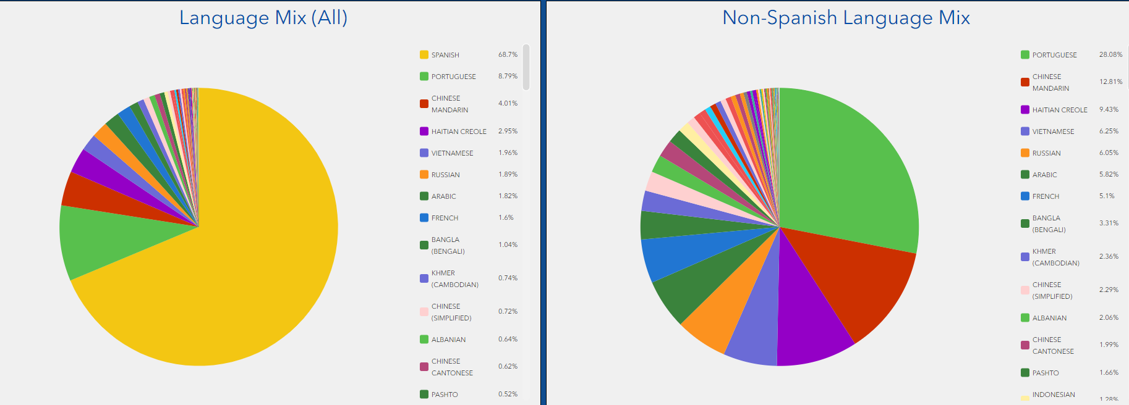
Language Selection
Philadelphia is currently home to roughly 1.6 million people
24.9% of this population speaks a language other than English per the 2020 census.
Thanks to the Philadelphia Office of Immigrant Affairs' Language Access Dashboard, we know that the city provided language translation services for 114 different languages since the FY2022 (LAP- Experience Builder (arcgis.com)

Slide 7
Language Selection
The Office of Immigrant Affairs (OIA) and the Office of People with Disabilities provided initial insight on the needs of local residents.
OIA had selected nine languages for their translation project:
The 7 most requested languages for city services: Arabic, Chinese, French, Portuguese, Spanish, Russian and Vietnamese
Two additional languages were added based on OIA’s Racial Equity goals and advocacy from local communities: Haitian Creole and Swahili
OEM added American Sign Language to reach d/Deaf and Hard-of-Hearing community members

Slide 8
Message Planning
All pre-scripted messages were translated, no live translations.
The pre-scripted messages were taken from our emergency message library and cover the following areas: weather, traffic, fire, response/recovery, evacuation/shelter in place
Written translations were done by Powerling, a professional translation company contracted by the City of Philadelphia. ASL messages were translated by the Deaf-Hearing Communication Center (DHCC), who is also contracted by the City of Philadelphia. ​
54 pre-scripted Emergency Alert Messages were translated​
43 are for different incidents/events​
11 are follow up messages to the above 43 messages​
Emergency alert messages that have not been translated will continue to be sent in English to all ReadyPhiladelphia account holders​.

Slide 9
Planning with, not for
Testing to ensure that the messages were clear and readable.
Final Process
Sent all messages through Everbridge to the reviewer
All messages in Chinese, Vietnamese, Russian, and Arabic were sent for a full review.
A percentage of messages in the remaining languages were went to OIA for review.
ASL messages were reviewed during an in person focus group hosted through Liberty Resources.

Slide 10
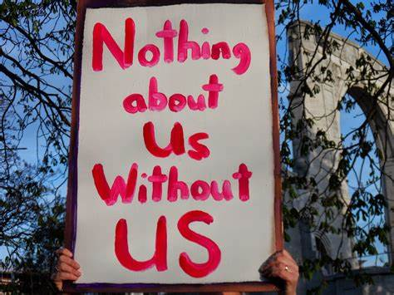
ASL Translation
Met with people from the community:
Office for People with Disabilities
Director of the ASL Program at the University of Pennsylvania
Regional Disability Integration Specialist for FEMA Region 3
Director, Independent Living, Liberty Resources
Advised to work with Certified Deaf Interpreters
Worked with the Deaf-Hearing Communication Center (DHCC) to record the videos
Editing and voice over was done in house

Slide 11
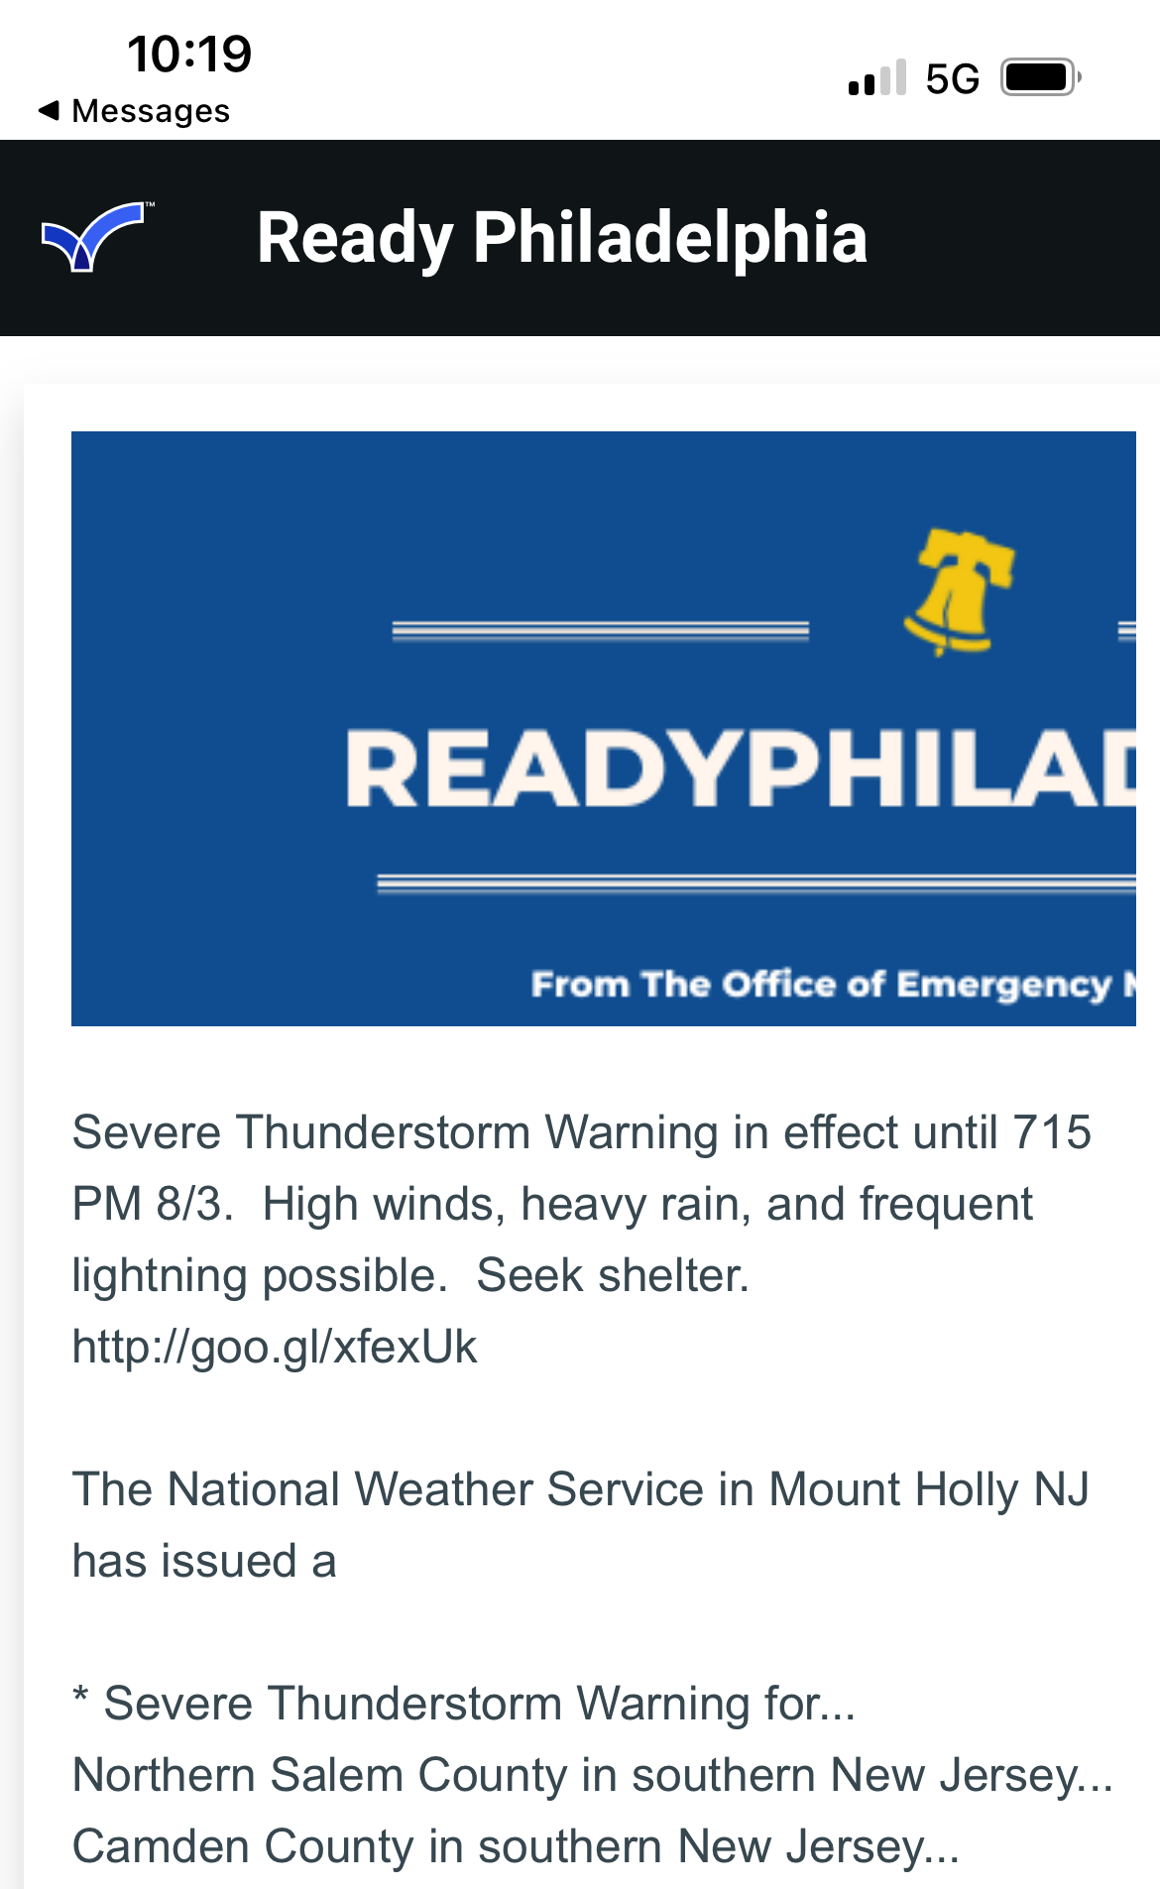
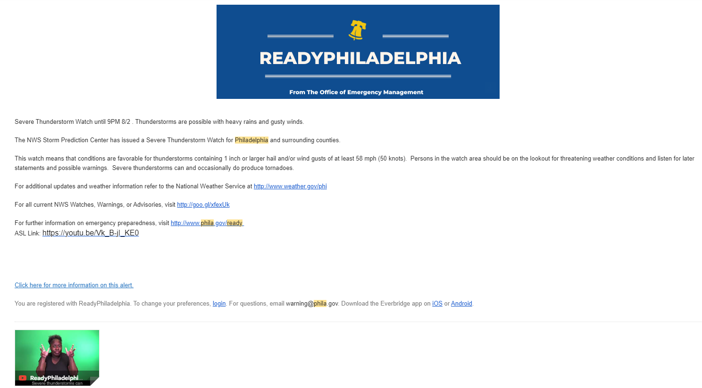
ASL Alerts

Slide 12
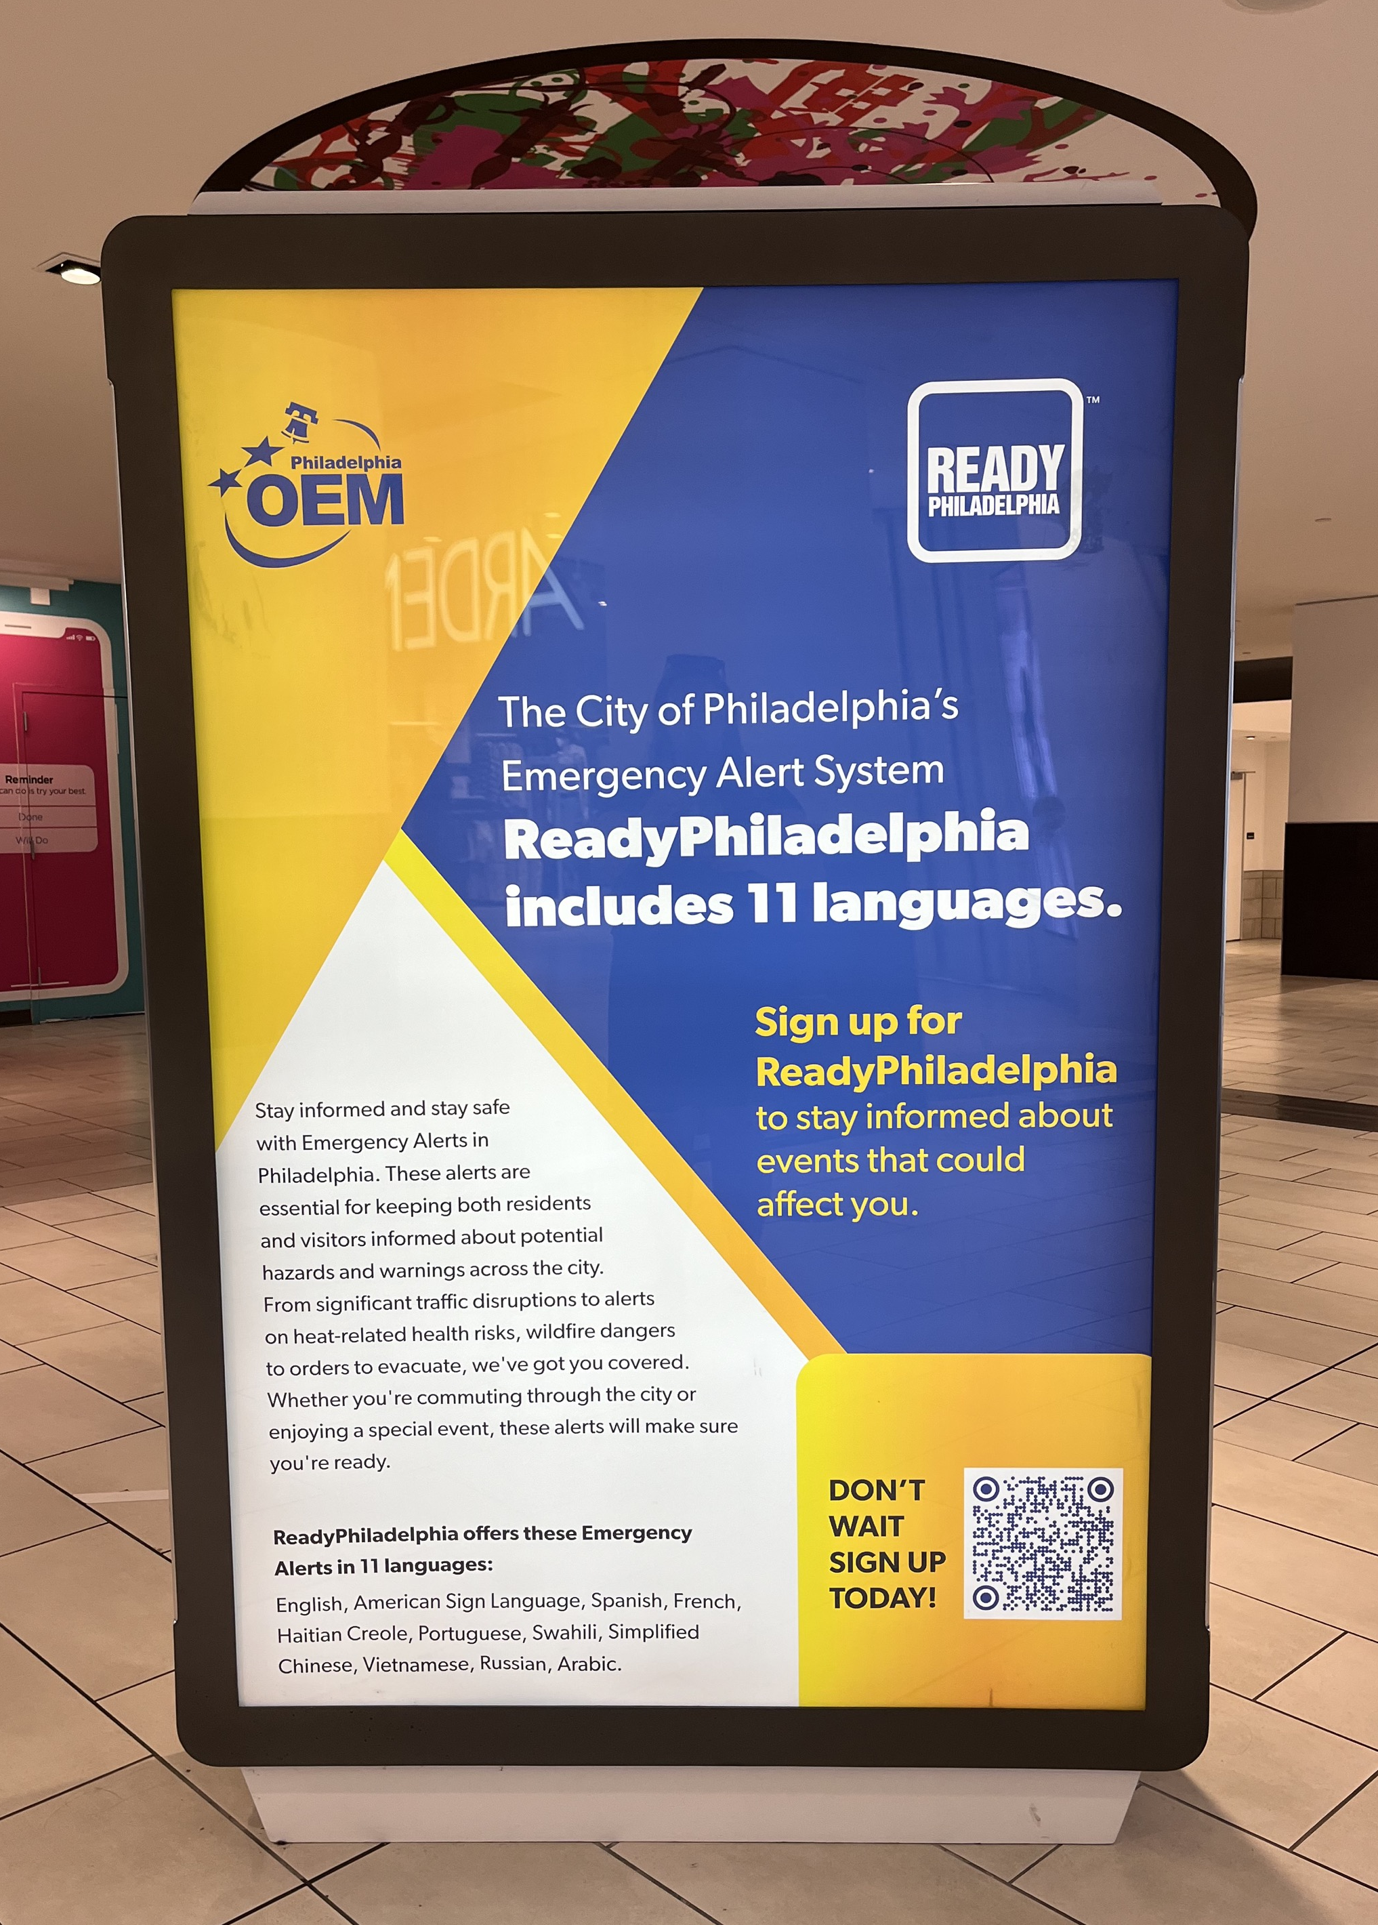
Launch and Outreach
Officially launched on June 17, 2024 with a launch message to all subscribers
30 multi-lingual emergency messages have been sent since that date
Ongoing outreach and advertising campaign lead by Community Engagement team
Outreach Efforts:
Translated outreach materials including flyers and postcards
Community-based organizations (CBOs) that support language access groups
Postcard mailers to Philadelphia school, library systems and CBOs
Social Media outreach
Outreach via Community Engagement events and partner amplification
Ongoing
Ads on a local Spanish radio station
Ads posted in the Fashion District
GIS mapping of language demographics throughout Philadelphia
Future ads on SEPTA bus stop structures
Digital assets owned by the City
Lights on Philadelphia Energy Company (PECO) building

Slide 13
Budget
This project was funded by an Operations Transformation Fund (OTF) grant awarded to us by the Chief Administrative Officer (CAO) of Philadelphia.
The purpose of this grant was to support transformative projects in Philadelphia city government by providing efficient and equitable services to Philadelphia residents.
Philadelphia OEM received $550,00 which was budgeted to cover the following:
Translated Emergency Alerts - $10,000
Place Based Message System - $400,000
Outreach - $140,000
Translation costs included:
Professional translation company
2 Certified Deaf Interpreters and ASL support to record ASL videos
Outreach

Slide 14
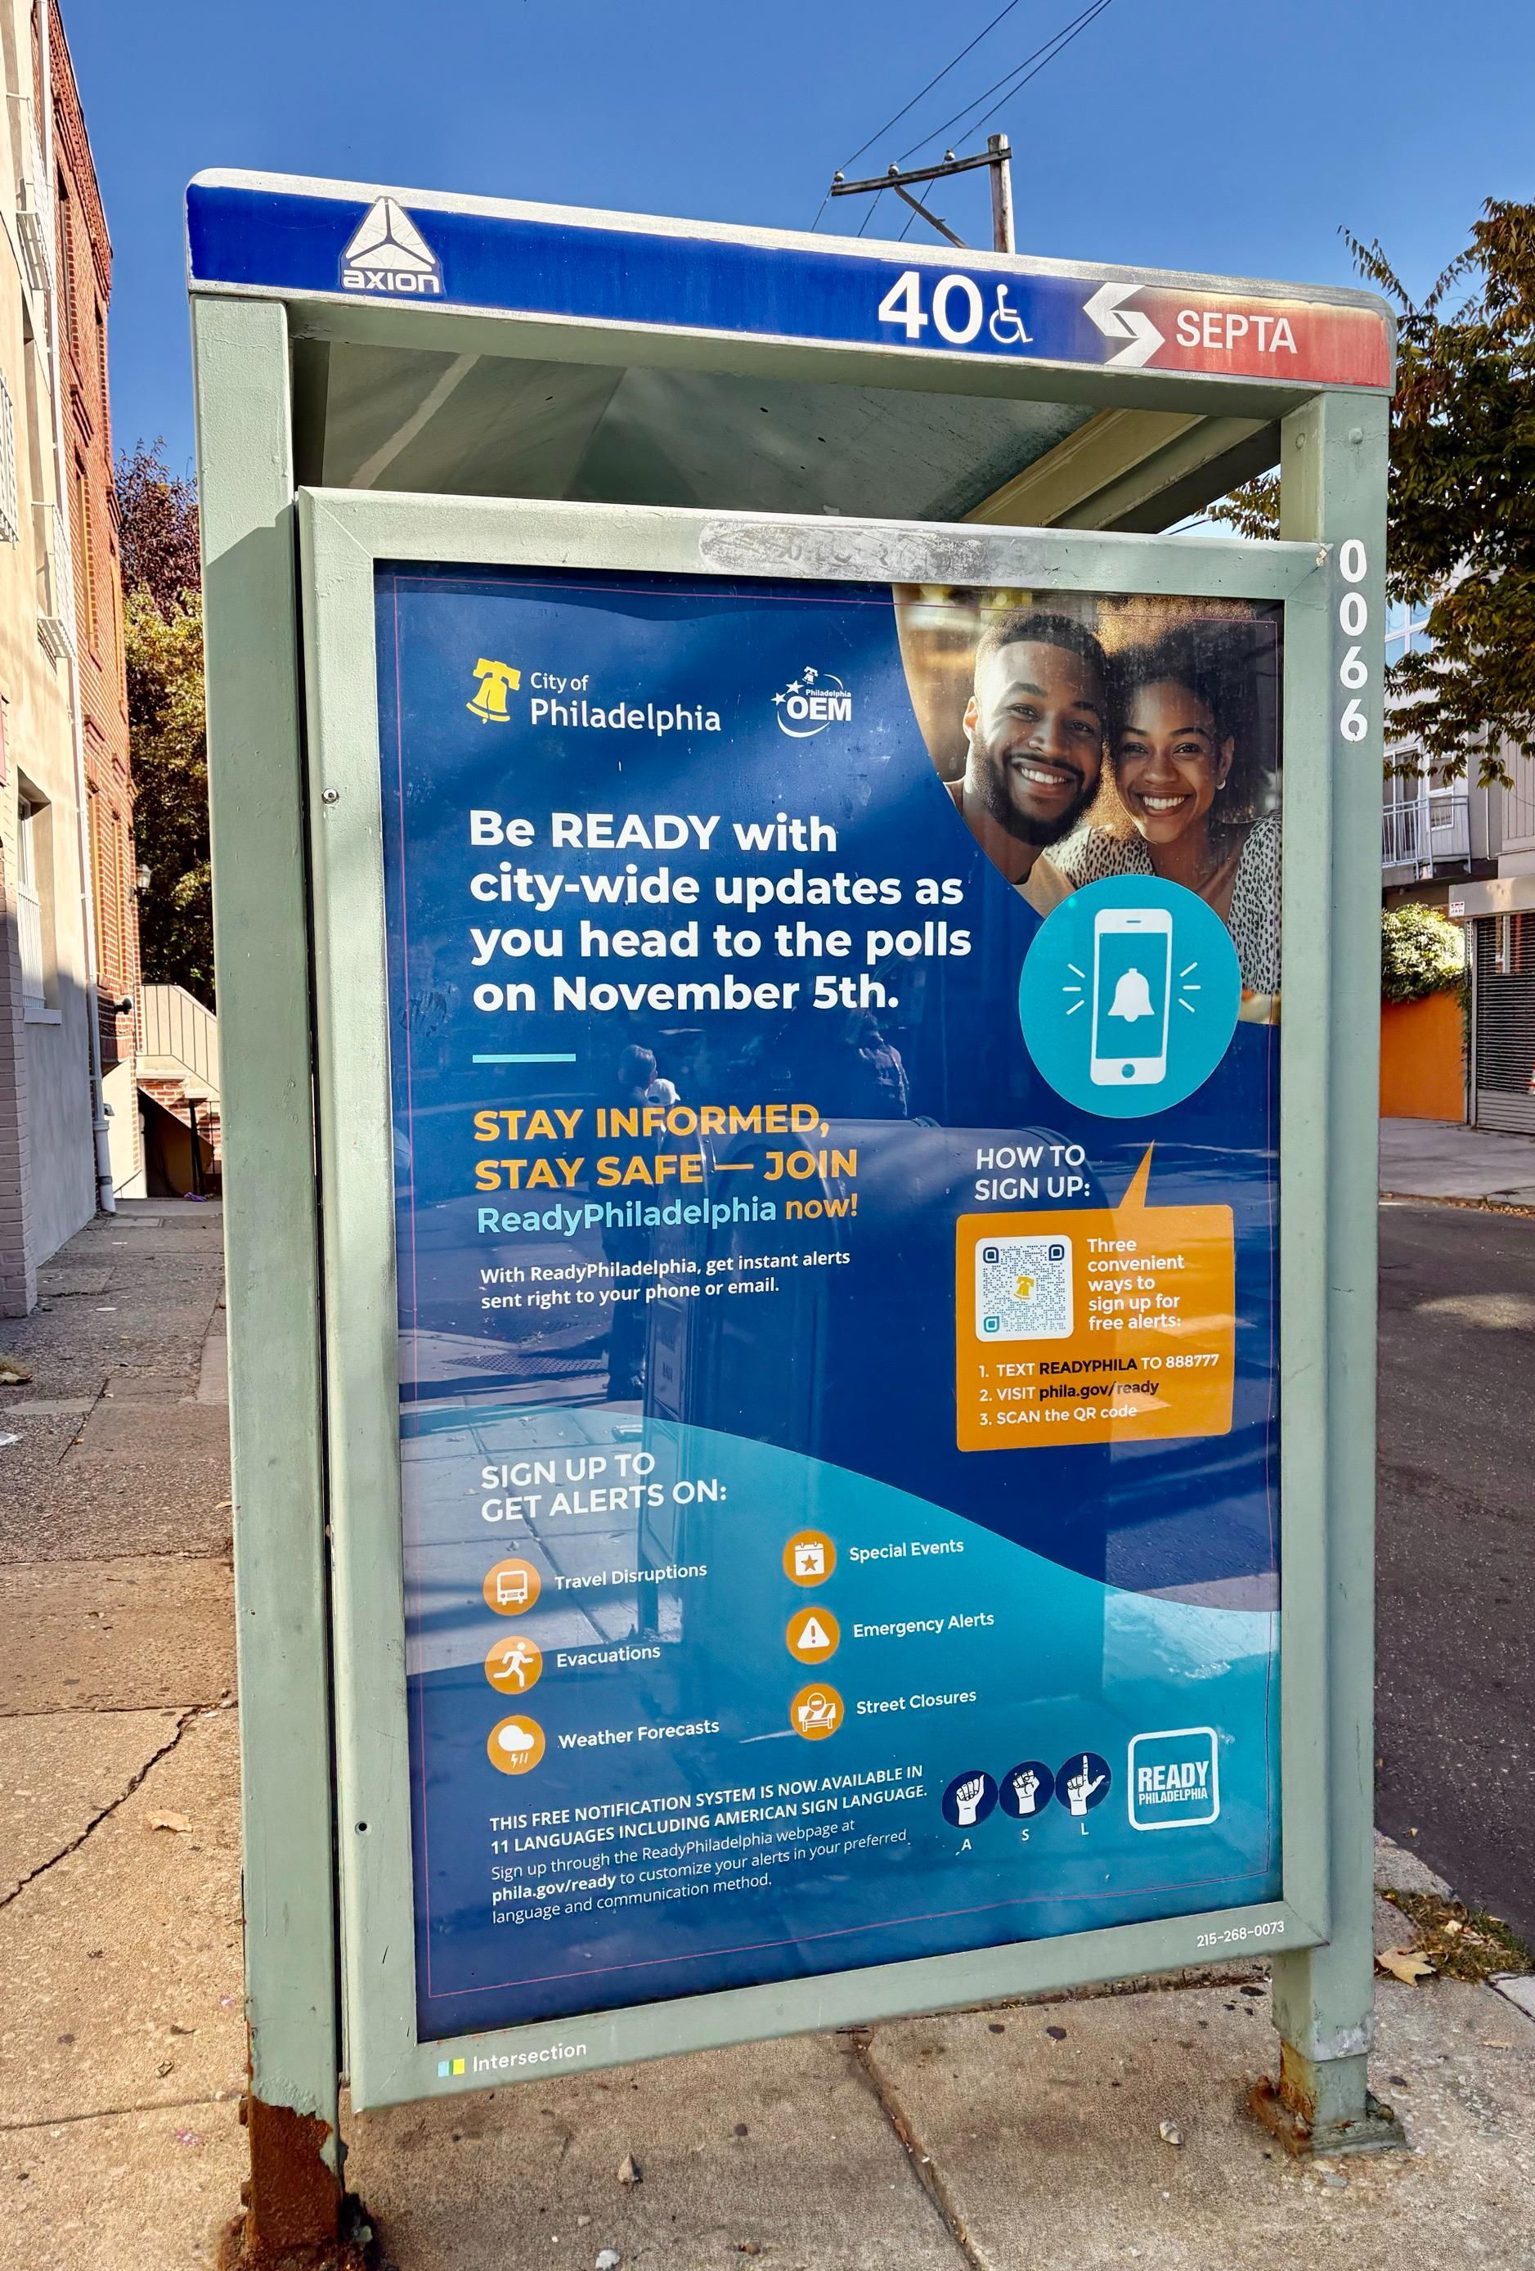
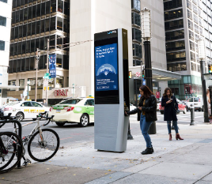
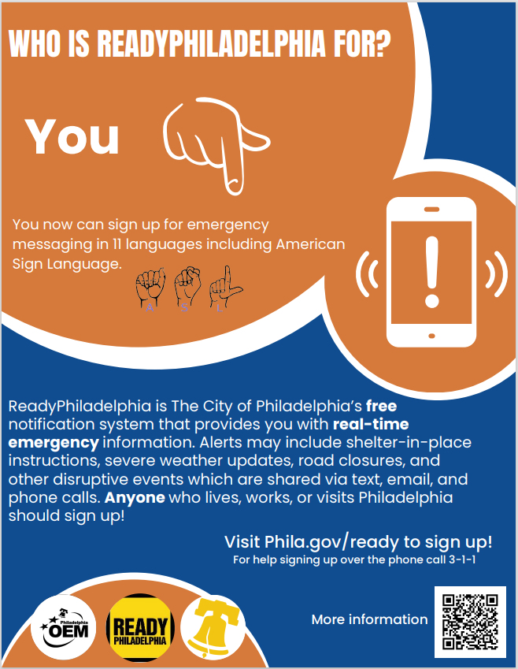
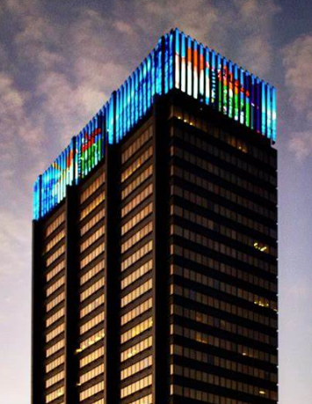
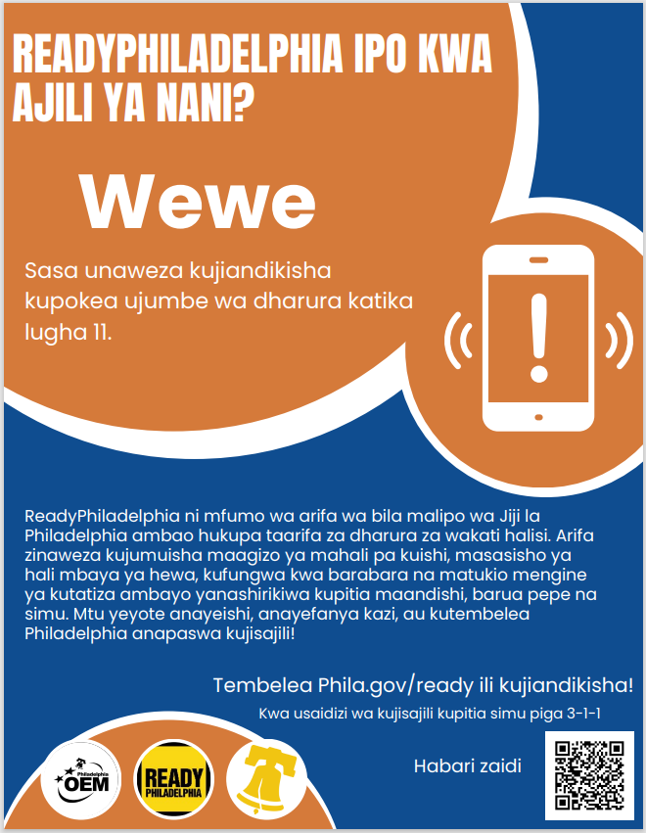
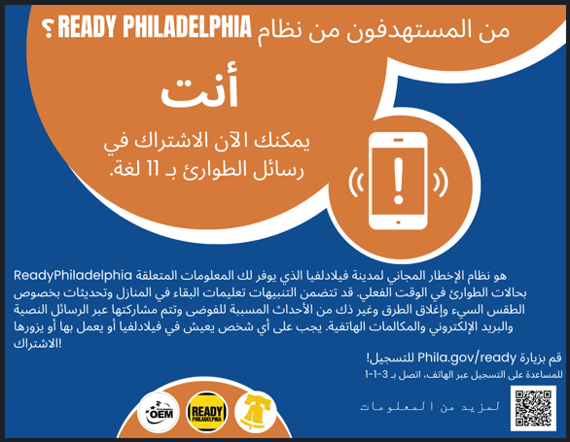
Advertising

Slide 15
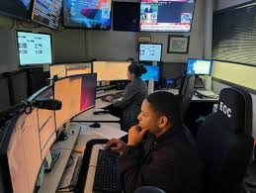
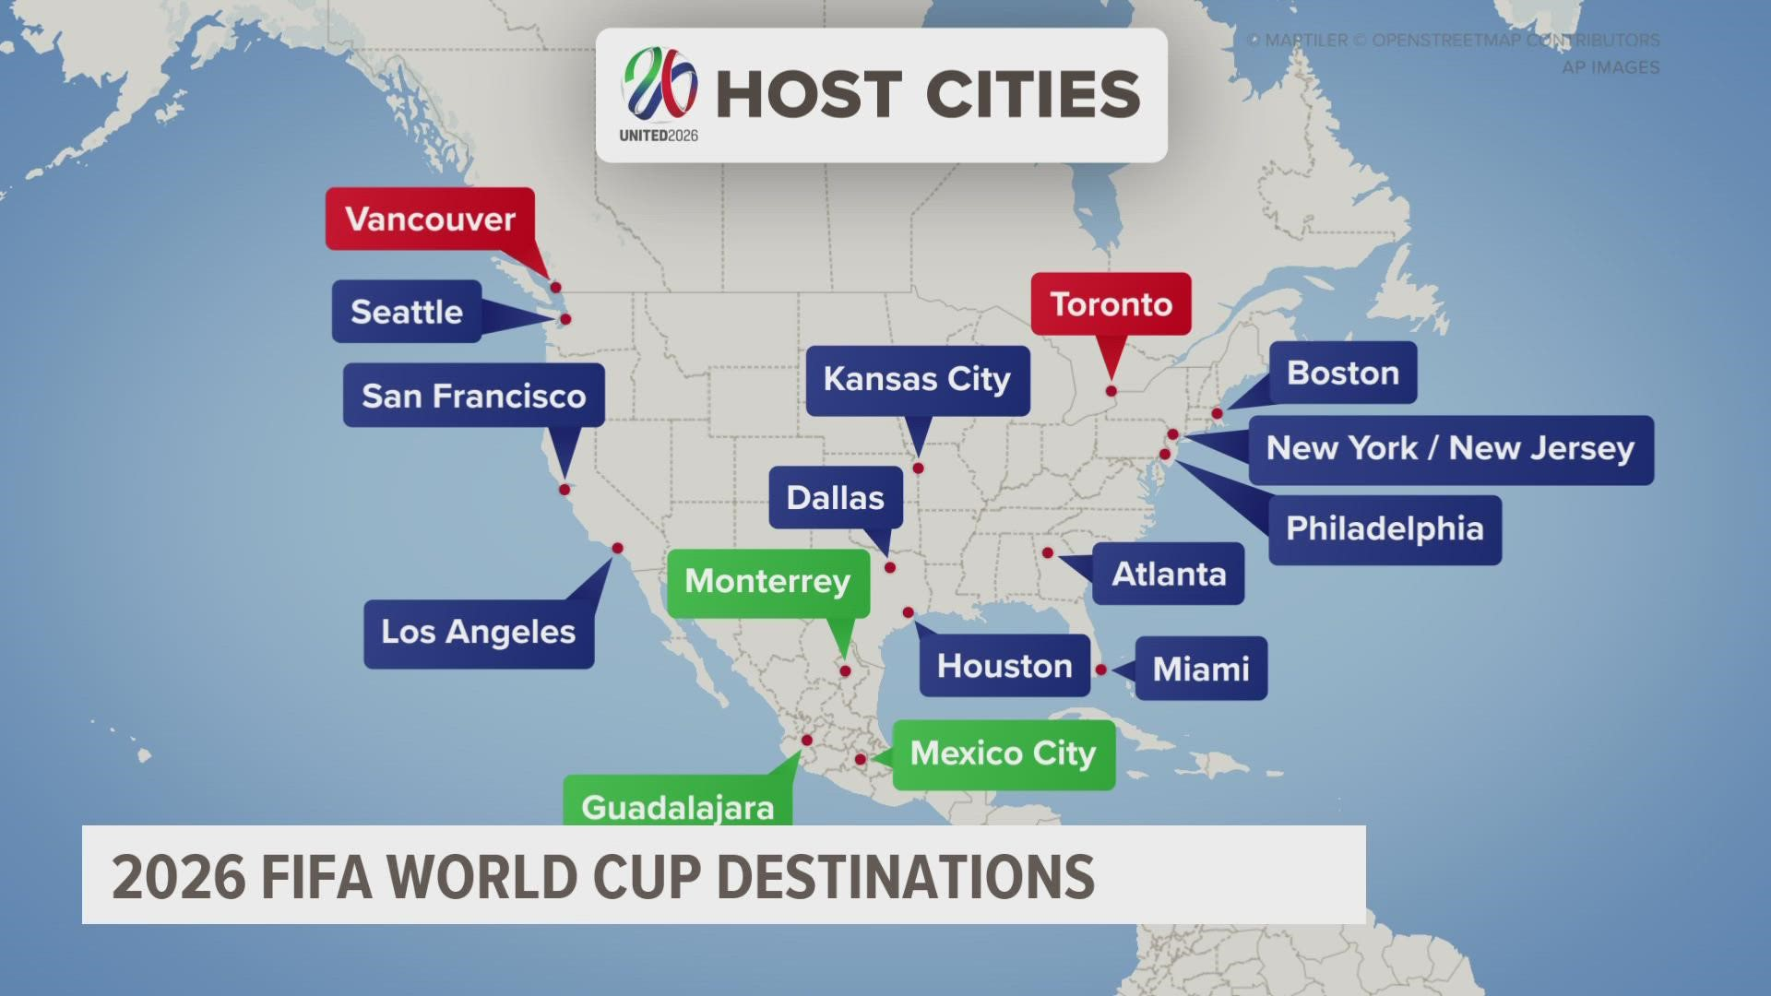
Next Steps for Multi-Lingual Alerts
Continued review and assessment of the system
Yearly updates to existing messaging
Adding more messages to our library
Continued conversation on live translations
FIFA 2026

