Slide 1
Including people with disability as a demographic in public health data collection and reporting
National Center on Birth Defects and Developmental Disabilities
Robyn A. Cree, PhD, Epidemiologist
Disability and Health Data and Science Team
Disability and Health Promotion Branch
Division of Human Development and Disability
Thursday May 9, 2024

Slide 2
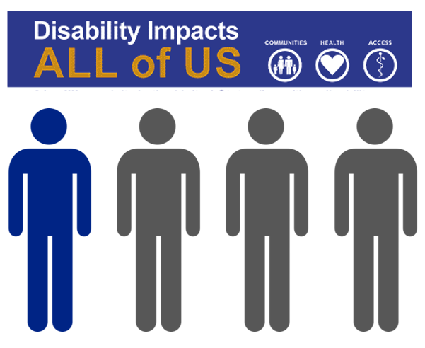
People with disabilities represent a key demographic
One in four adults in the United States has a disability*
*2021 Behavioral Risk Factor Surveillance System (27.2%)

Slide 3
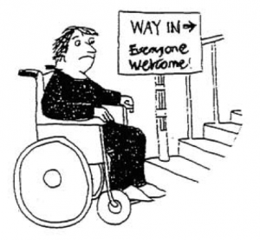
How we think about disability matters
Her impairment is the problem! They should cure her or give her prosthetics.
The stairs are the problem! They should build a ramp.
The medical model of disability
The social model of disability
University of Illinois Disability Theory; https://guides.library.illinois.edu/c.php?g=549817&p=3774564
Association of University Centers on Disabilities; https://disabilityinpublichealth.org/1-1/

Slide 4
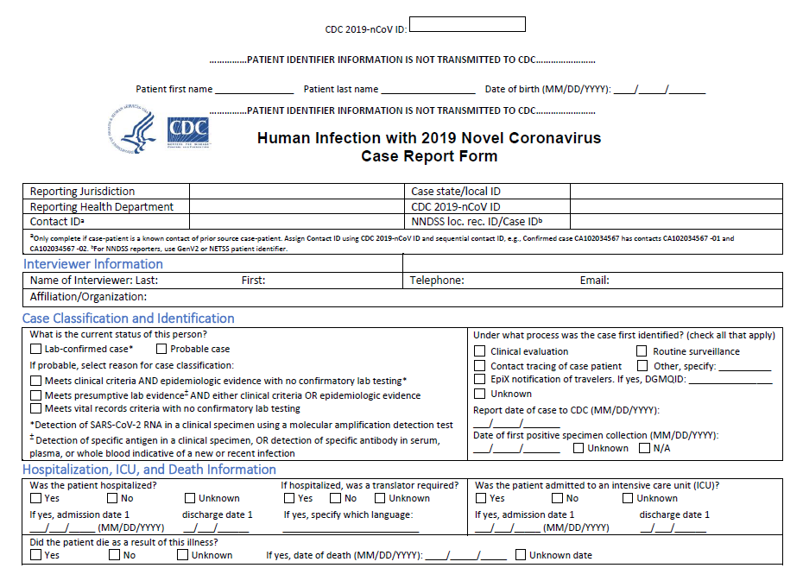
COVID-19 pandemic illustrated a dire need for better data on people with disabilities
Disability status rarely completed in COVID-19 case report forms
Paucity of data in the literature

Slide 5
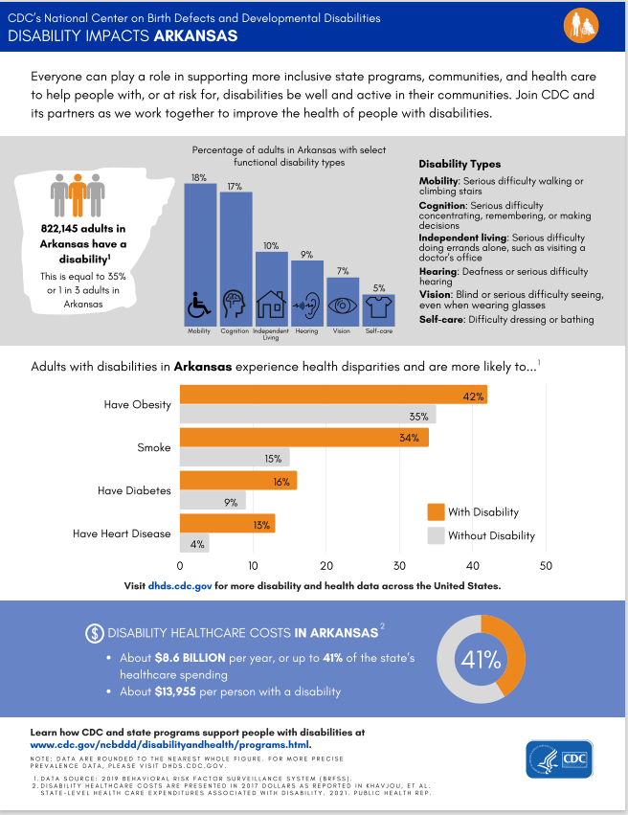
Data
Need different, better, and faster...and inclusive…
ongoing public health and emergency preparation and response

Slide 6
Thank you
For more information please contact:
Robyn Cree, PhD
nru7@cdc.gov

Slide 7
This project was supported by funds made available from the Centers for Disease Control and Prevention, Center for State, Tribal, Local and Territorial Support, through cooperative agreement OT18-1802, Strengthening Public Health Systems and Services Through National Partnerships to Improve and Protect the Nation’s Health award #6 NU38OT000303-04-02. Copyright © 2024 Centers for Disease Control and Prevention. All rights reserved.

