Slide 1
Recommendations, training and resources to build local city-county health and disability partnerships: lessons from the field
Sara Lyons, MPH (she/her)
Senior Program Analyst, Health and Disability
slyons@naccho.org

Slide 2
Partnership Recommendations
Community-based organizations and advocates representing the local disability community are critical partners in supporting local public health inclusion initiatives.
Examples of partners:
Centers for Independent Living (CILs)
University Centers for Excellence in Developmental Disabilities (UCEDDs)
Special Olympics local chapters

Slide 3
Centers for Independent Living Directories
Administration for Community Living (ACL) Directory
https://acl.gov/programs/centers-independent-living/list-cils-and-spils
Independent Living Research Utilization (ILRU) Directory
https://www.ilru.org/projects/cil-net/cil-center-and-association-directory

Slide 4
Partnership Examples from the Field
Addressing the Needs of People with Disabilities in Preparedness and Response Planning
Partnering with Centers for Independent Living on Vaccine Access
Disability inclusion within the community health assessment and community health improvement planning process

Slide 5
NACCHO Trainings
Health and Disability 101 Training for Health Department Employees
https://www.pathlms.com/naccho/courses/5037
Leveraging Partnerships with Disability Organizations
https://www.pathlms.com/naccho/courses/46354

Slide 6
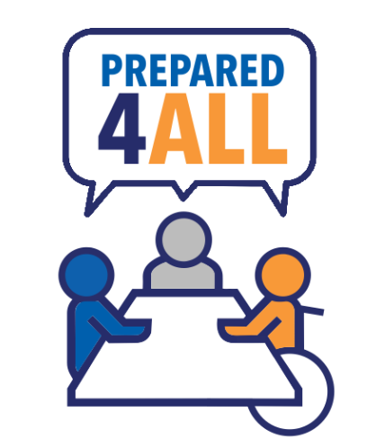
AUCD Prepared4All Training
Training available on AUCD’s National Center on Disability in Public Health
https://nationalcenterdph.org/our-focus-areas/emergency-preparedness/prepared4all/online-training/

Slide 7
Resources
Explore how to form effective and reciprocal partnerships with Centers for Independent Living (CILs) to support the health and wellbeing of people with disabilities.
https://www.naccho.org/uploads/downloadable-resources/CDC_Foundation_Partnership_Guide_2023-508.pdf

Slide 8
For Additional Information
NACCHO’s Health and Disability Program
https://www.naccho.org/programs/community-health/disability
Sara Lyons, MPH
slyons@naccho.org

Slide 9
This project was supported by funds made available from the Centers for Disease Control and Prevention, Center for State, Tribal, Local and Territorial Support, through cooperative agreement OT18-1802, Strengthening Public Health Systems and Services Through National Partnerships to Improve and Protect the Nation’s Health award #6 NU38OT000303-04-02. Copyright © NACCHO. All rights reserved.

