Slide 1
Virginia walkability action institute
Charles T. Brown, MPA, CPD, LCI

Slide 2
BACKGROUND
Adults are Overweight/Obese

Slide 3
Background on diabetes
BACKGROUND
Adults with Diabetes

Slide 4
Background on colesterol
BACKGROUND
Adults with High Cholesterol

Slide 5
Background on hypertension
BACKGROUND
Adults with Hypertension

Slide 6
Background on no physical activity
BACKGROUND
Adults with No Physical Activity

Slide 7
Background on pedestrian injury
BACKGROUND
pedestrian injury crashes at mid-block crossing
pedestrian injury crashes without a marked crosswalk
pedestrian fatal crashes without a marked crosswalk

Slide 8
So What?!

Slide 9
THE WHY?
Activity-friendly communities encourage physical activity

Slide 10
The why: make communities healthier and safer
THE WHY
Creating or modifying environments can make our communities heathier and safer places to live, work, place, learn, and worship

Slide 11
VIRGINIA
WALKABILITY
ACTION INSTITUTE

Slide 12
PURPOSE
Equity, Inclusion, & Justice
Places
Cross-Sector Collaborations
Resources & Funding
Policies
Mobility/
Moveability
Programming
Data & Monitoring

Slide 13
GOAL
prepare local/regional multi-sector teams and individuals in pursuing policy, systems, and environmental changes and interventions to improve population health and reduce chronic disease risk and burden through increased access to physical activity, with a primary focus on walkability.

Slide 14
Goal 2
GOAL

Slide 15
impact
120+ Virginians Trained
25 Experts/Faculty
18 Localities
24 Diverse Teams
Over 1M Virginians Impacted

Slide 16
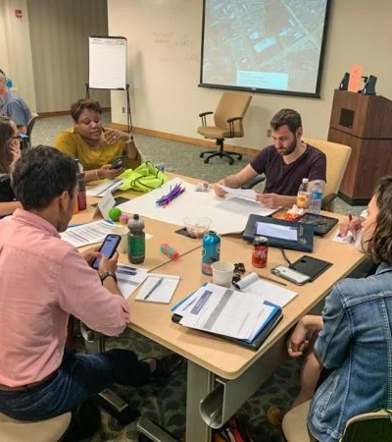
VWAI Cohort
What to Expect

Slide 17
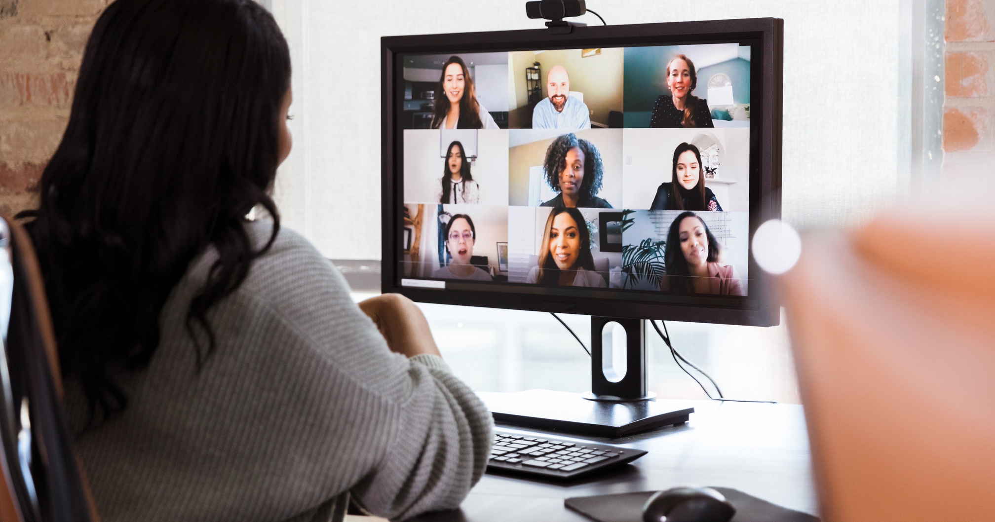
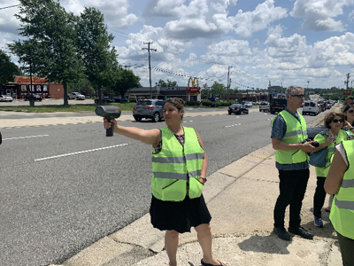
LEARNING OPPORTUNITIES

Slide 18
TOPICS
Health Equity
Transportation Equity
Road Safety Assessments with VDOT
Segregated by Design
The Decriminalization of Jaywalking in Virginia
Transportation & Art
Tactical Urbanism Training
Complete Streets
Safe, Calm & Slow Streets
Building Multi-sectoral Partnerships
Performance Measures
Navigating the Municipal and State Policy Process
Building & Maintaining Relationships with City Leadership

Slide 19
VWAI PERKS
Invitation to attend all VWAI in-person meetings, distance learning modules, and technical assistance/office hours sessions
Opportunity to participate in a community site visit(s)
Opportunity to participate in a Road Safety Assessment
Access to public health, walking, biking, public transit, and micro-mobility experts, tools and resources
Access to special project funding: $30,000
Opportunity to impact your community

Slide 20
Notable Projects

Slide 21
City of Waynesboro, Virginia

Slide 22
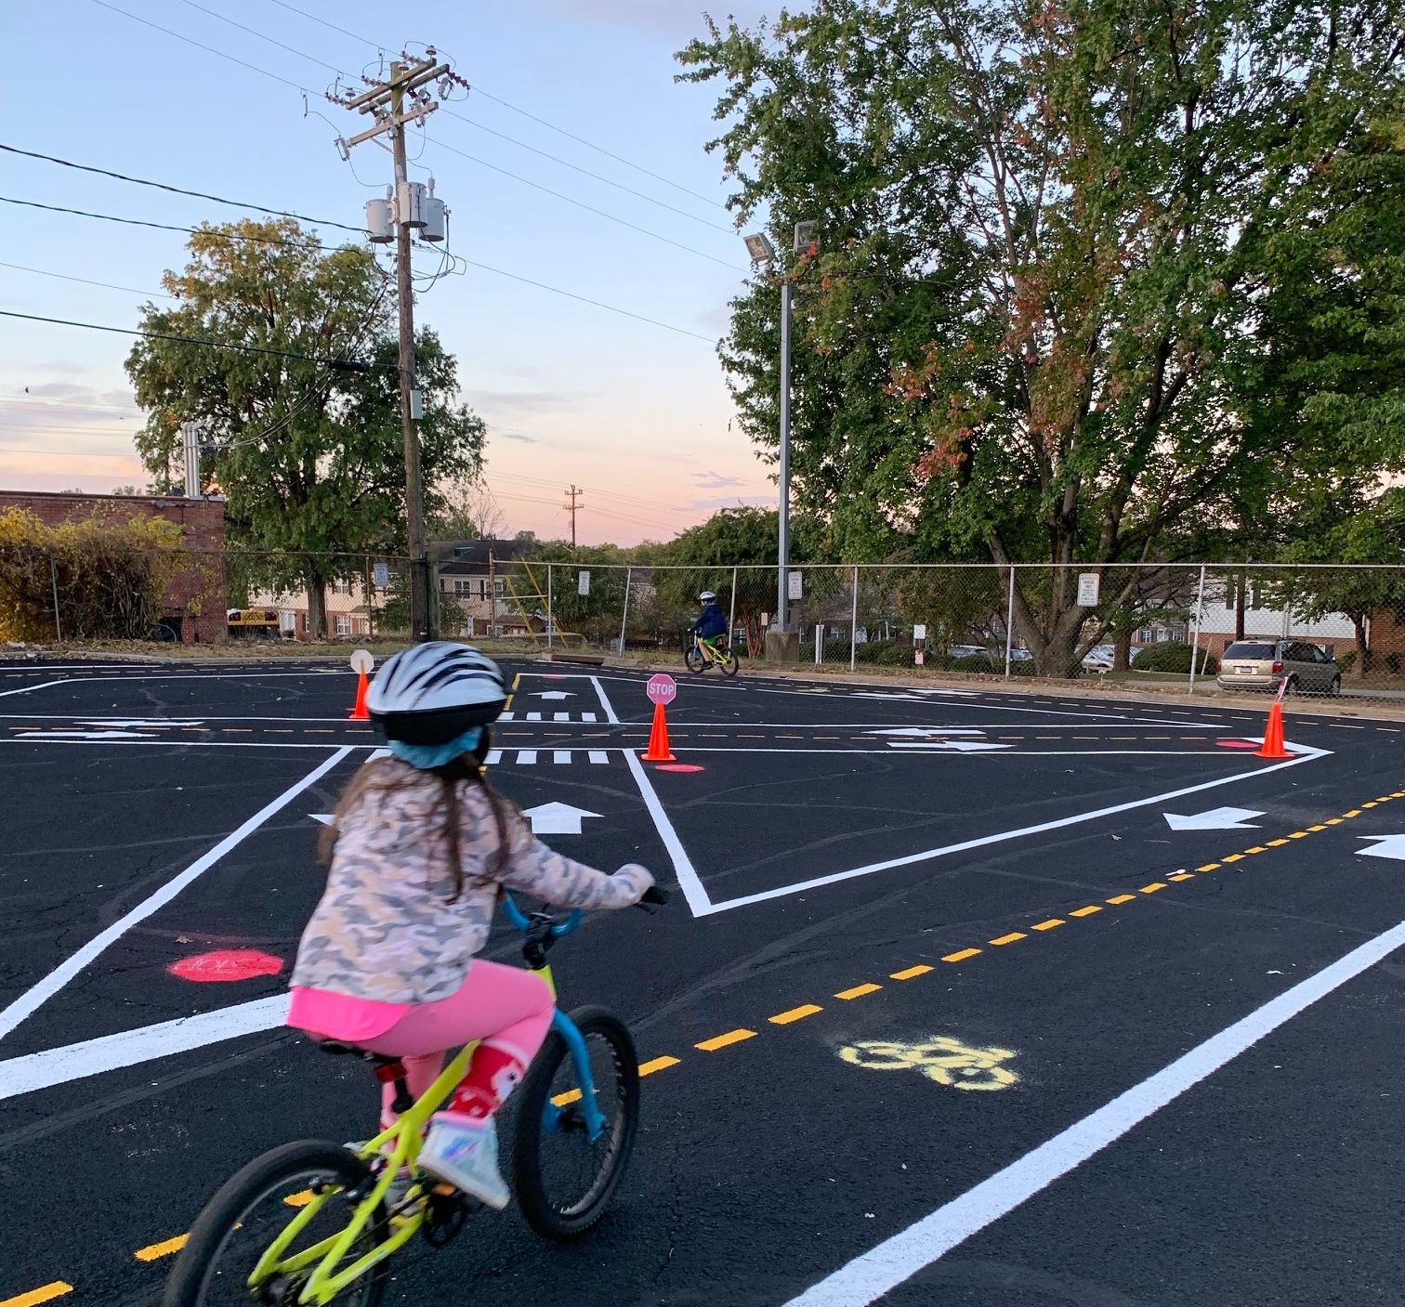
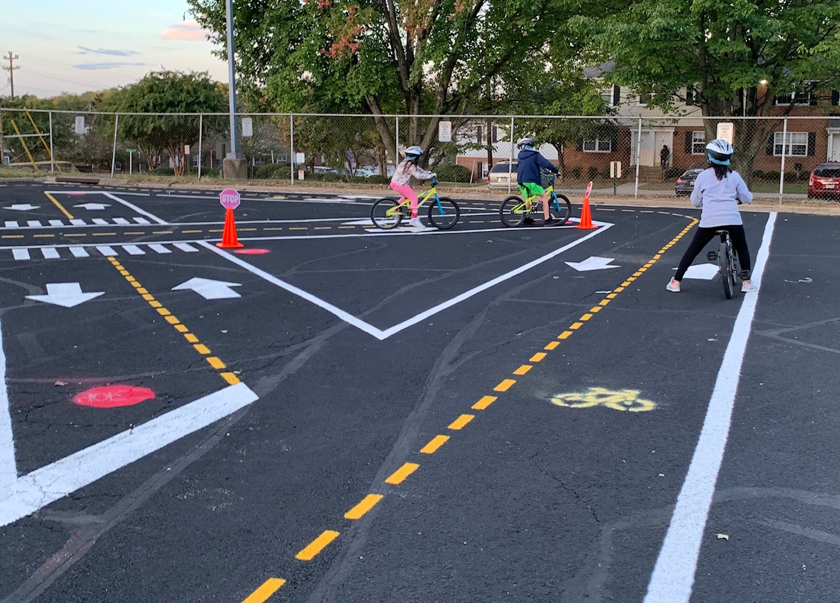
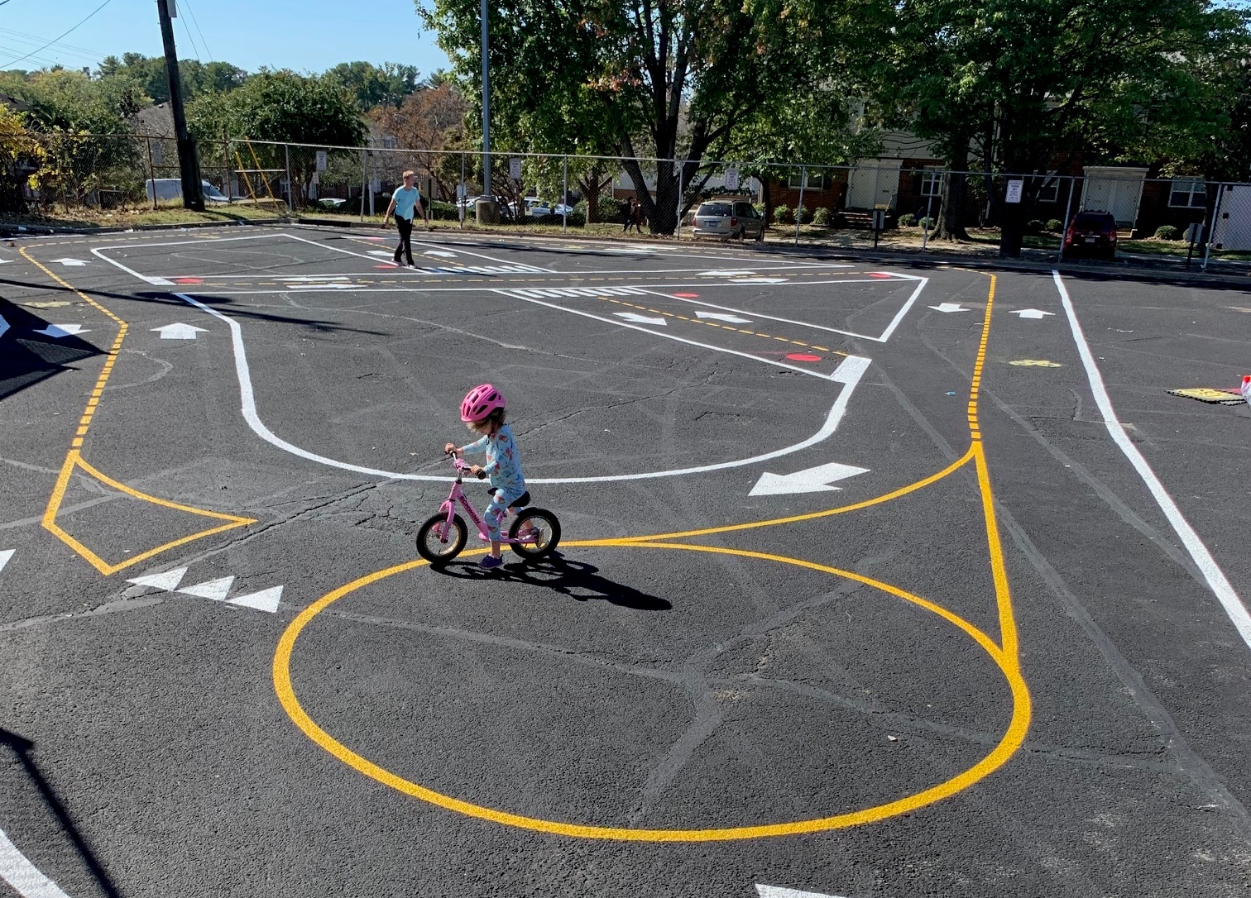
Fairfax County, Virginia

Slide 23
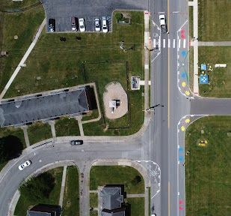
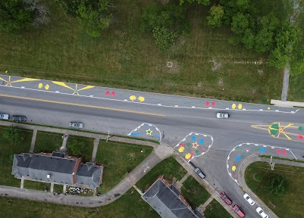
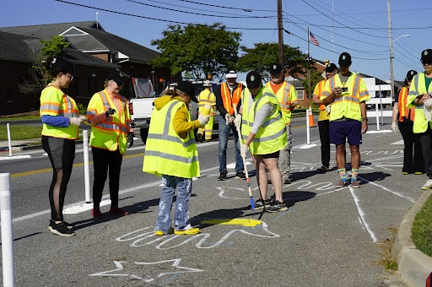
City of Roanoke, Virginia

Slide 24
Health Departments can lead the way encouraging and creating inclusive public health projects!

Slide 25
Thank You!
Charles T. Brown, MPA, CPD, LCI
Email: charlesbrown@equitablecities.com
www.equitablecities.com

Slide 26
This project was supported by funds made available from the Centers for Disease Control and Prevention, Center for State, Tribal, Local and Territorial Support, through cooperative agreement OT18-1802, Strengthening Public Health Systems and Services Through National Partnerships to Improve and Protect the Nation’s Health award #6 NU38OT000303-04-02. Copyright © 2024 Equitable Cities, LLC. All rights reserved.

