Slide 1
Including people with disability as a demographic in public health data collection and reporting
National Center on Birth Defects and Developmental Disabilities
Robyn A. Cree, PhD, Epidemiologist
Disability and Health Data and Science Team
Disability and Health Promotion Branch
Division of Human Development and Disability
Thursday May 9, 2024
Notes:
First, I will provide a little background on how our program thinks about disability and why it is so important that this demographic is represented in our public health data systems.
Then I will share a few examples of CDC-funded projects to increase representation of people with disabilities in public health data collection and reporting.

Slide 2
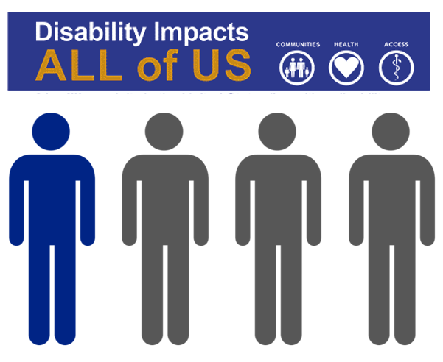
People with disabilities represent a key demographic
One in four adults in the United States has a disability*
*2021 Behavioral Risk Factor Surveillance System (27.2%)
Notes:
Cleared slide from NSSP CoP Meeting, Jan 2022 (originally from BRFSS Webinar, August 2021)
People with represent a key demographic. As many as 1 in 4 of the US adult population reports having one or more disabilities according to recent estimates from BRFSS; and nearly 1 of 10 children has a disability according to recent estimates from the national survey of children’s health (https://jamanetwork.com/journals/jamapediatrics/fullarticle/2773471).
Most people will have a disability at some point across the lifespan.
People with disabilities are a diverse population. Disabilities can affect a person’s: vision, hearing, movement, thinking, remembering, learning, communicating, mental health, and social relationships.
In addition to different types of disabilities, people with disabilities have many different identities, including all race/ethnicities, sexual orientations, and gender identities.
The experiences of people with disabilities often depend on these intersecting identities.
It is important to understand that having a disability should not mean having poor mental or physical health. Although disability is associated with health conditions (such as arthritis, mental, or emotional conditions) or events (such as injuries), the functioning, health, independence, and engagement in society of people with disabilities can vary depending on several factors such as:
Severity of the underlying impairment
Social, political, and cultural influences and expectations
Aspects of natural and built surroundings
Availability of assistive technology and devices
Family and community support and engagement
Images:
https://www.cdc.gov/ncbddd/disabilityandhealth/disability-inclusion.html
https://www.cdc.gov/ncbddd/disabilityandhealth/disability.html

Slide 3
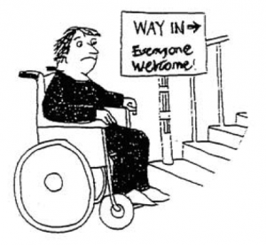
How we think about disability matters
Her impairment is the problem! They should cure her or give her prosthetics.
The stairs are the problem! They should build a ramp.
The medical model of disability
The social model of disability
University of Illinois Disability Theory; https://guides.library.illinois.edu/c.php?g=549817&p=3774564
Association of University Centers on Disabilities; https://disabilityinpublichealth.org/1-1/
Notes:
Cleared slide from NSSP CoP Meeting, Jan 2022, originally from BRFSS Webinar, August 2021
It is essential that we include people with disabilities in ALL aspects of public health, including data collection. If we exclude people with disabilities, we will not be able to serve the needs of our communities.
But how can we include people with disabilities as a demographic in our data systems? First, we need to take a step back to recognize that how we think about disability matters.
This is a cartoon taken from the University of Illinois that describes two models of disability theory. The bubble on the left represents the medical model of disability, where a disability is seen as an impairment that health care providers should cure or treat. The medical model has been criticized by many researchers and disability advocates because it does not acknowledge that many see disability as an important part of their identity, not something to be cured. This model ignores the important fact that people with disabilities can live healthy and meaningful lives.
In contrast, the bubble on the right represents the social model of disability, which sees society and how it is organized as the problem. For example, the problem has nothing to do with the person, but the fact that the building is inaccessible and excludes them from participation. A simple fix, such as a ramp, would make the building accessible to everyone.
Measurement of disability as a demographic is complex, and many different definitions exist.
CDC defines disability as any condition of the body or mind that makes it more difficult for the person with the condition to do certain activities and interact with the world around them. Six common types of disability include vision, hearing, mobility, cognition, independent living, and self-care.
Based on the WHO International Classification of Functioning (ICF)
Recognizes that disability is a product of both individual functional impairment and exclusion from social participation
Includes three main dimensions of disability: body structure/function, activity, and participation
Measurement of disability on surveys often focuses on activity limitations within the ICF framework. Activity is defined as the execution of a task or action by an individual. The American Community Survey 6-question set and the WGSS are two examples of questionnaires that focus on activity limitations that are commonly included on surveys.
Another way disability is measured is by using presence of one or more diagnostic codes when demographic information indicating whether a person has a disability is unavailable, for example in research or surveillance using medical claims or electronic health records. Focusing on diagnosed health conditions results in an inherent challenge for measuring disability, as diagnostic codes do not map on directly to functional limitations. However, until disability is collected as a demographic at the point of care, diagnostic codes are sometimes the only way to identify people with disabilities within data systems.
(source: AUCD; https://disabilityinpublichealth.org/1-1/)

Slide 4
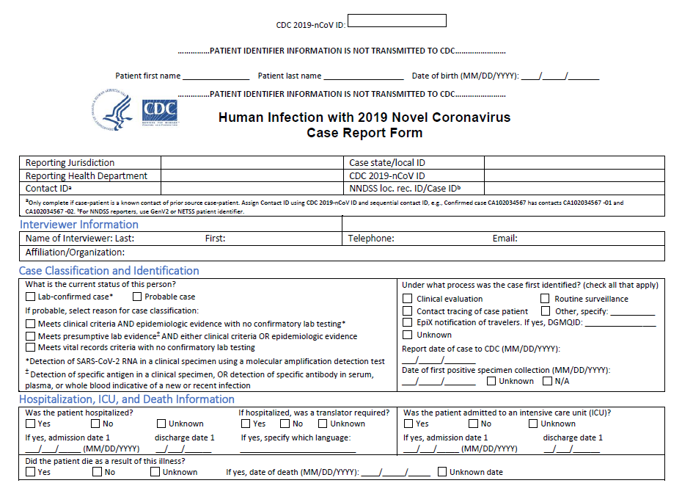
COVID-19 pandemic illustrated a dire need for better data on people with disabilities
Disability status rarely completed in COVID-19 case report forms
Paucity of data in the literature
Notes:
Cleared slide presented by Cathy Rice, October 2023
The COVID-19 pandemic illustrated a dire need for better data on people with disabilities.
Many existing data systems do not include information about disability, meaning that decisions are often made without considering the needs of people with disabilities. The COVID-19 pandemic was no exception.
The COVID case report form had disability listed, however it was included under the underlying medical conditions section (as neurologic neurodevelopmental, intellectual, physical, vision or hearing impairment), not as a demographic. This question was missing in vast majority of cases (only filled out 7% of the time), and was ultimately removed.
A lack of data in the early days of the pandemic meant that with disabilities were not included on CDC’s underlying medical conditions page.
This page was never intended to be a prioritization schema for early vaccination, but it became one.
So many people, who we would later find out were at increased risk, were not able to get vaccinated as early as we would have liked.
This, and many other countless examples, show that collecting disability status ALL THE TIME, in a way that is similar to other demographic groups such as sex, race, and ethnicity, is essential.

Slide 5
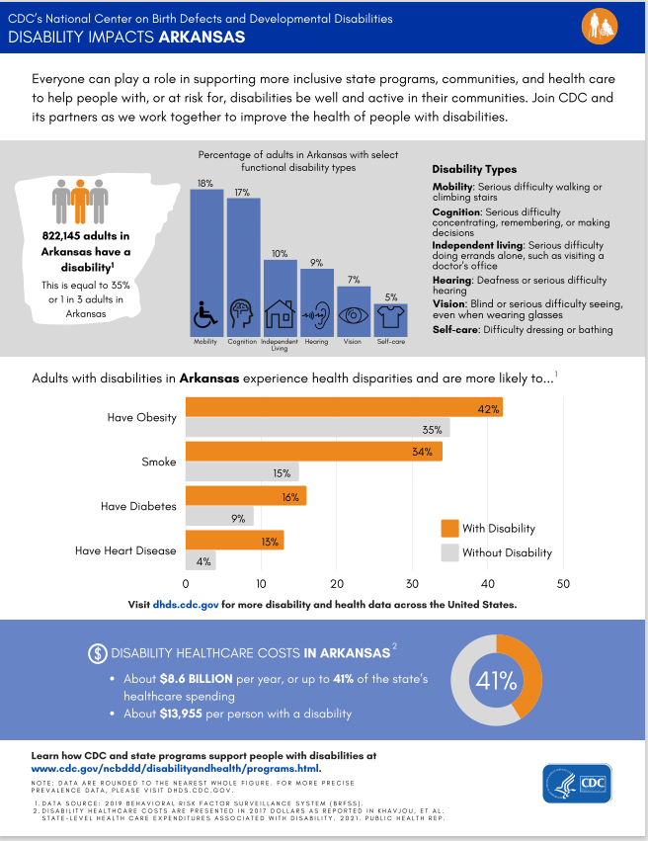
Data
Need different, better, and faster...and inclusive…
ongoing public health and emergency preparation and response
Notes:
Cleared slide presented by Cathy Rice, October 2023
CDC is working collaboratively with our partners and people with disabilities to increase representation of people with disabilities as a demographic in our data systems.
Shown on this slide is a screen shot of one of our state profiles which provides an overview of disability and health in each state, the District of Columbia, Guam, and Puerto Rico.
These data come from our Disability and Health Data System (DHDS), which is a web portal providing vital information to better understand the health needs of adults with disabilities using Behavioral Risk Factor Surveillance System (BRFSS) data
Monitors the health of people with disabilities
Supports health program planning, disability research, and emergency planning
A second project is one we are wrapping up in a few months titled: Defining disability for syndromic surveillance
The National Syndromic Surveillance Program (NSSP) is a core CDC surveillance system used to detect outbreaks and monitor public health emergencies through surveillance of emergency department (ED) visits.
However, prior to this project, there has been no way to identify people with disabilities within this system.
In collaboration with the Association of State and Territorial Health Officials and the National Syndromic Surveillance Program Community of Practice, we have engaged a scientific panel including people with disabilities and syndromic surveillance experts to develop definitions to identify emergency department visits from people with disabilities
We will be disseminating and promoting use of definitions for disability this summer.
These definitions can be used to disaggregate monitored health outcomes by disability status and type and will ultimately help improve emergency and ongoing surveillance efforts
A third project is titled Improving identification of adults with intellectual and developmental disabilities at the point of seeking care
Standard disability survey question sets capture seeing, hearing, mobility, cognition, self care, independent living, and communication
Recent analyses with SO found that, while nearly all SO athletes self-identified as having an intellectual/learning disabilities, less than 10% reported a significant cognitive difficulty
This 3 year project aims to increase representation of people with IDD in administrative data systems by engaging people with IDD and close informants to develop a functional disability demographic checklist including IDD to supplement existing survey questions in a checklist format for use at the point of care.
Finally, a fourth project is titled Advancing Equity in State, Tribal, Local, and Territorial Emergency Response for People with Disabilities
This work is in response to the fact that information included in state-level Emergency Operations Center, or EOC, Situation Reports that inform response efforts at the state and national level may not include data on the health and response needs of people with disabilities.
This likely stems from a general lack of available case-level data on people with disabilities; however, data sources do exist which are available to jurisdictions that can help inform emergency response & recovery.
CSTE in collaboration with CDC
Assessed data collection and sharing methods on people with disabilities during public health emergencies at the state & territorial level
Identified areas of improvement related to data collection, data sources, and data sharing for information on people with disabilities during public health emergencies through gaps analysis
Currently developing a standardized template to be used by jurisdictions for reporting data on people with disabilities in emergency response situational reports
Creating educational materials for STLT public health agencies on importance of capturing and reporting disability data during public health emergency responses
Standardized reporting template to be included in situational reports can be used for capturing and reporting data to inform state-level response for public health intervention to reduce morbidity and mortality, promote health equity, and meet the needs of people with disabilities during disaster response.
These are just a few examples of the work CDC is doing in collaboration with partners, including people with disabilities, to increase representation of people with disabilities across all of our public health data systems.

Slide 6
Thank you
For more information please contact:
Robyn Cree, PhD
nru7@cdc.gov

