Slide 1
Equitable Access to Active Transportation for Persons with Disabilities
Data that can help frame community projects
Charles T. Brown, MPA, CPD, LCI
NNPHI Session II
1:00 p.m. – 2:00 p.m. eastern time
Email: charlesbrown@equitablecities.com
Notes:
Hello: My name is Charles T. Brown. My pronouns are (he/him)
I’m in my last year as an early middle-aged, Black male with a bald head, a black beard. I’m wearing a blue shirt and am presenting from my home office in NJ.
Building on our first webinar, I would like to expand our conversation to discuss the importance of data to help create equitable access to active transportation for persons with disabilities.

Slide 2
"Accessibility is not a privilege; it is a fundamental right. Ensuring that every individual, regardless of their abilities, has equal access to our public spaces and transportation systems isn't just about compliance—it's about affirming dignity, promoting independence, and building a truly inclusive society."– Anonymous.
Notes:
"Accessibility is not a privilege; it is a fundamental right. Ensuring that every individual, regardless of their abilities, has equal access to our public spaces and transportation systems isn't just about compliance—it's about affirming dignity, promoting independence, and building a truly inclusive society."– Anonymous.
In order to ensure every individual has access, we need to continue to advocate for equity and more specifically transportation equity.
What is equity? Next slide

Slide 3
What is Equity?
Equitable Access
Equity means the consistent and systematic treatment of all individuals in a fair, just, and impartial manner, including individuals who belong to communities that often have been denied such treatment
This includes communities often impacted by equity issues such as racial & ethnic minorities, persons with disabilities, marginalized groups, geographically disadvantaged, economically disadvantaged, and intersectional identities
Source: Executive Order on Further Advancing Racial Equity and Support for Underserved Communities Through The Federal Government
This Photo by Unknown Author is licensed under CC BY-NC
Notes:
What is Equity?
(a) The term “equity” means the consistent and systematic treatment of all individuals in a fair, just, and impartial manner, including individuals who belong to communities that often have been denied such treatment, such as Black, Latino, Indigenous and Native American, Asian American, Native Hawaiian, and Pacific Islander persons and other persons of color; members of religious minorities; women and girls; LGBTQI+ persons; persons with disabilities; persons who live in rural areas; persons who live in United States Territories; persons otherwise adversely affected by persistent poverty or inequality; and individuals who belong to multiple such communities.
Source: https://www.whitehouse.gov/briefing-room/presidential-actions/2023/02/16/executive-order-on-further-advancing-racial-equity-and-support-for-underserved-communities-through-the-federal-government/#:~:text=(a)%20The%20term%20%E2%80%9Cequity,American%2C%20Native%20Hawaiian%2C%20and%20Pacific

Slide 4
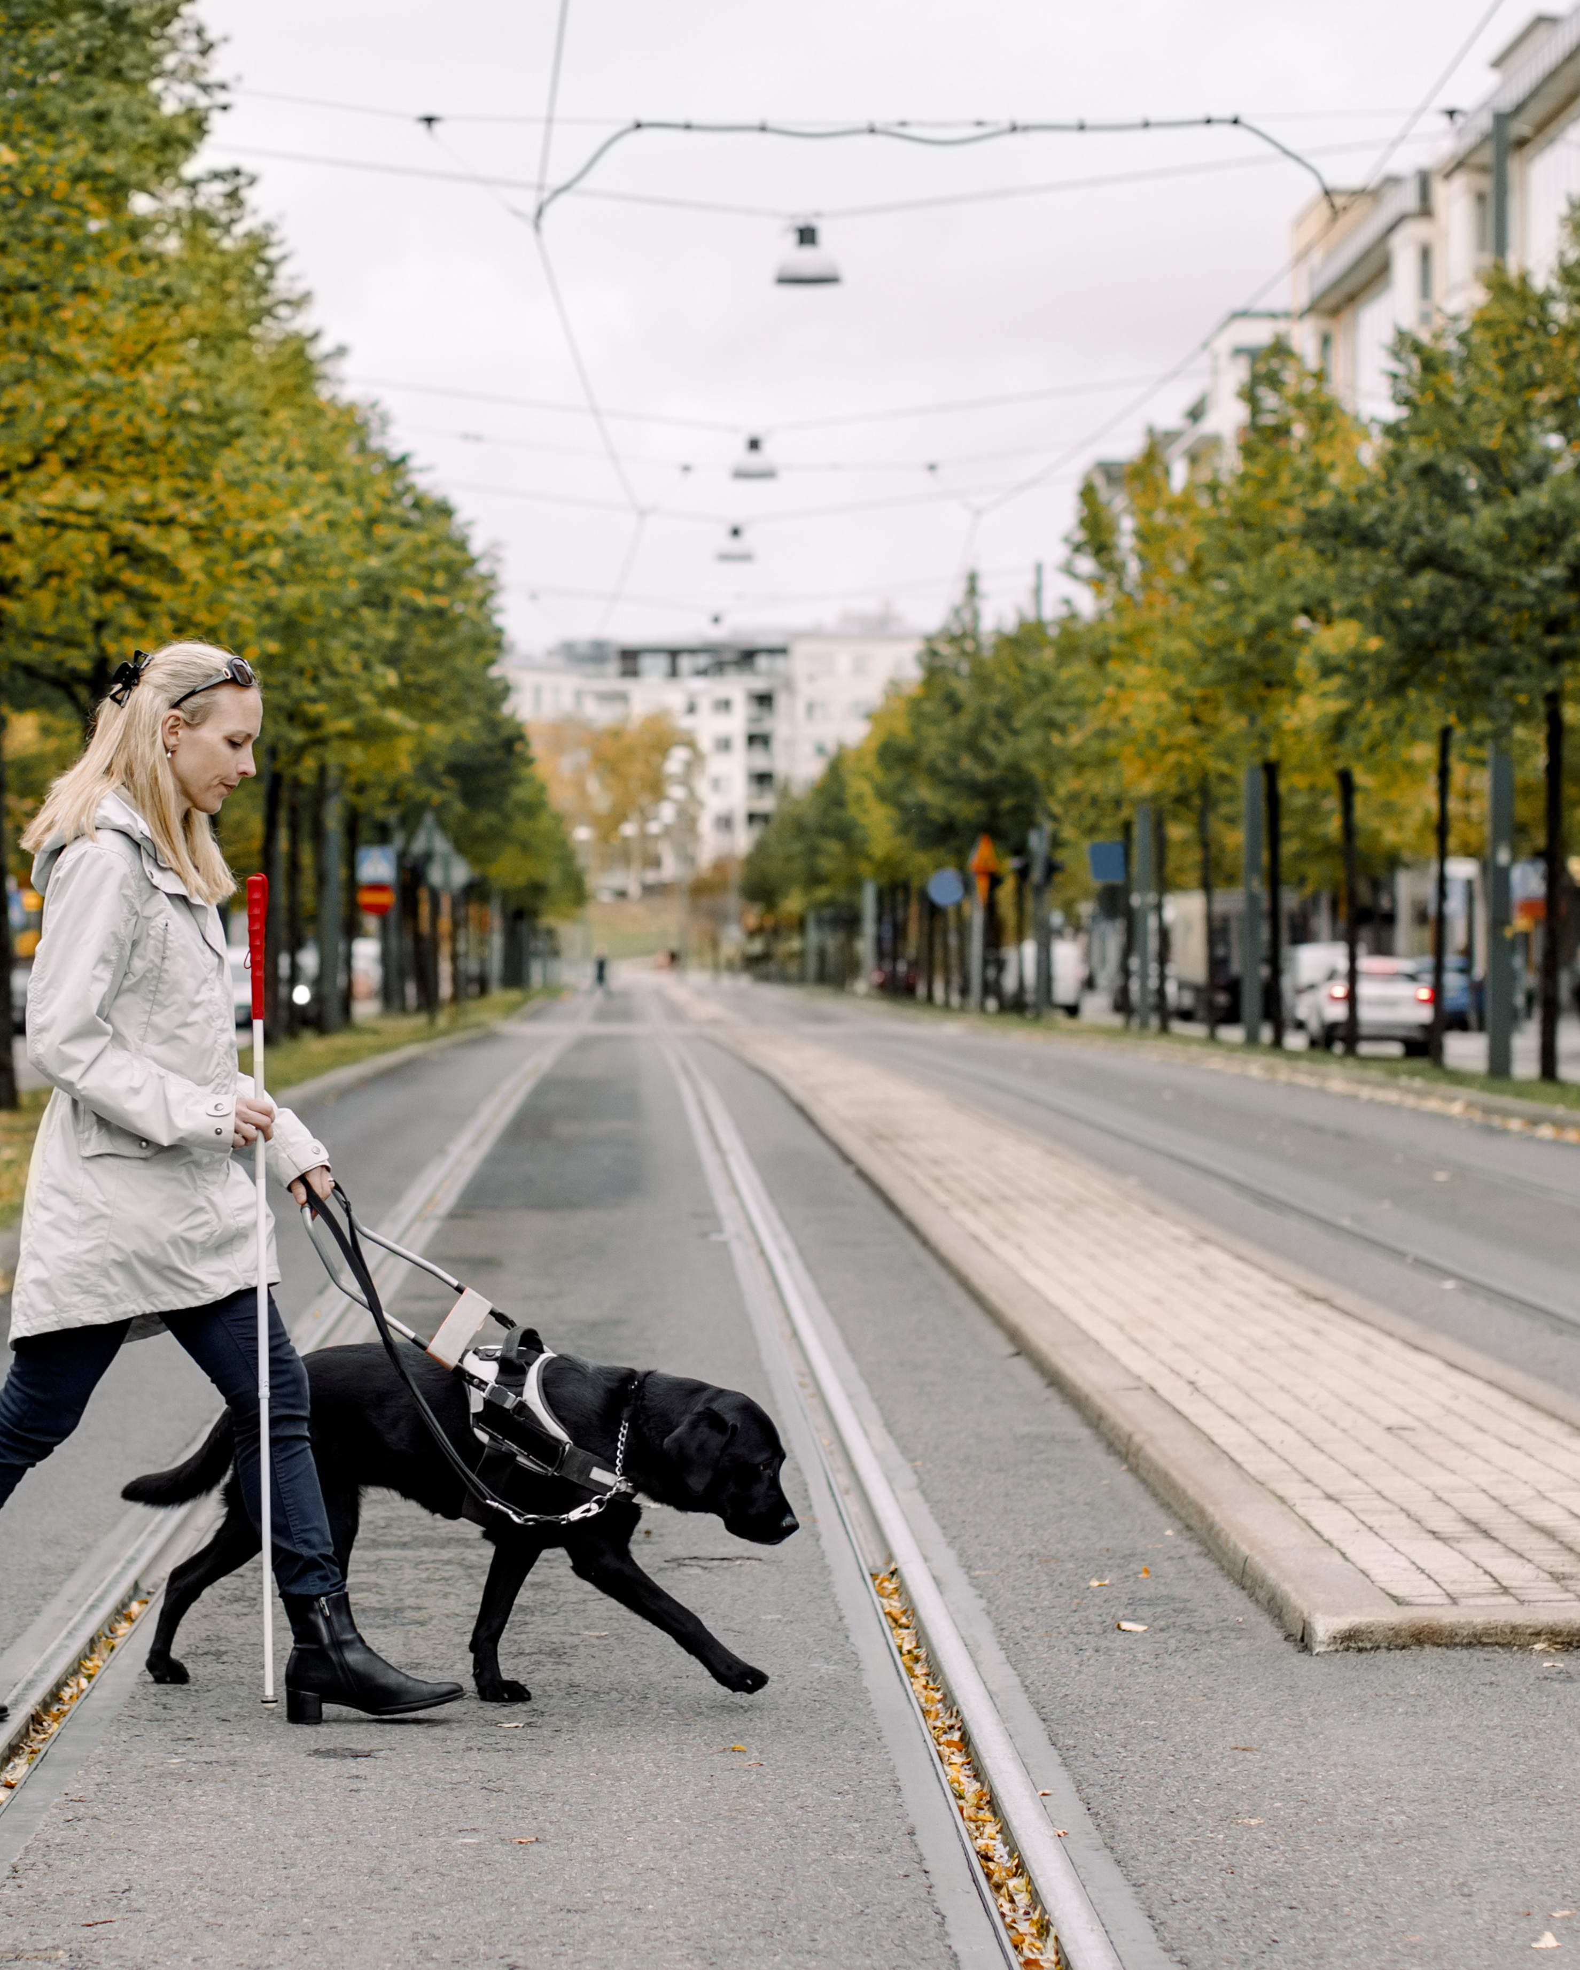
What is Transportation Equity?
Equitable Access
The principle of ensuring fair and just access to transportation resources, infrastructure, and services across all segments of society
Key Aspects
Accessibility
Inclusivity
Affordability
Safety and Reliability
Environmental Justice
Community Engagement
Notes:
What is transportation equity?
Transportation equity refers to the principle of ensuring fair and just access to transportation resources, infrastructure, and services across all segments of society. This concept emphasizes that everyone, regardless of their socio-economic status, race, age, ability, or geographic location, should have access to safe, reliable, and affordable transportation options.
Here are some key aspects of transportation equity:
Accessibility: Ensuring that transportation systems are physically and economically accessible to all, including people with disabilities, elderly populations, and those living in rural or underserved urban areas.
Inclusivity: Transportation planning and services should consider the diverse needs of the community, including those of marginalized and historically underrepresented groups.
Affordability: Keeping transportation costs reasonable so that low-income individuals and families can afford to travel for work, education, healthcare, and other essential services without financial strain.
Safety and Reliability: Providing safe and reliable transportation options that protect all users, including pedestrians, cyclists, and public transit riders, from harm.
Environmental Justice: Ensuring that transportation systems contribute to environmental sustainability and do not disproportionately impact low-income and minority communities with pollution and other negative externalities.
Community Engagement: Involving communities in the transportation planning process to ensure that the services meet their needs and preferences and that their voices are heard in decision-making processes.
Transportation equity is critical for creating inclusive, sustainable communities where all individuals have the opportunity to thrive without being limited by mobility constraints.

Slide 5
Many transportation professionals often are unaware or simply ignore existing data on active transportation accessibility for persons with disabilities.
Notes:
"The health of a community is a direct reflection of the lives of its residents." – Unknown.

Slide 6
How Might We Redesign for All?
Equitable Access
Universal Design Principles:
Apply universal design principles in public spaces and buildings to ensure accessibility for people with disabilities.
This goes beyond minimum legal requirements to create spaces that are genuinely usable and welcoming for everyone.
This Photo by Unknown Author is licensed under CC BY-NC-ND
Notes:
How can we help? Universal Design Principles: Apply universal design principles in public spaces and buildings to ensure accessibility for people with disabilities. This goes beyond minimum legal requirements to create spaces that are genuinely usable and welcoming for everyone.

Slide 7
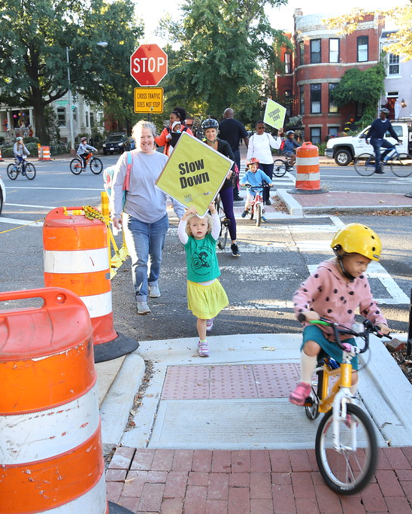
How Might We Redesign for All? (part 2)
Equitable Access
Walkable and Bike-Friendly Infrastructure:
Design streets and neighborhoods that prioritize pedestrians and cyclists over cars.
This includes safe sidewalks, bike lanes, traffic calming measures, and pedestrian zones, encouraging active transportation and reducing reliance on vehicles.
Notes:
Walkable and Bike-Friendly Infrastructure: Design streets and neighborhoods that prioritize pedestrians and cyclists over cars. This includes safe sidewalks, bike lanes, traffic calming measures, and pedestrian zones, encouraging active transportation and reducing reliance on vehicles.

Slide 8
Data on Active Transportation Accessibility for Persons with Disabilities
Equitable Access
Observed Limitations and Data Needs
Limited scope of geographic coverage
Lack of granularity regarding types of disabilities
Infrequency of data collection
Challenges in data collection
Needs:
Detailed mobility data across different types of disabilities
User satisfaction and safety perception data
Data on access to key destinations (e.g., parks)
This Photo by Unknown Author is licensed under CC BY-NC-ND
Notes:
Data on Active Transportation Accessibility for Persons with Disabilities
Observed Limitations and Data Needs
Limited Scope of Geographic Coverage: Often, data collection efforts are concentrated in urban or more densely populated areas, leaving rural and less populated regions underrepresented. This can lead to a lack of understanding and addressing the unique challenges faced by persons with disabilities in these less covered areas, resulting in uneven policy and infrastructure development.
Lack of Granularity Regarding Types of Disabilities: Data that is collected often does not differentiate sufficiently between different types of disabilities (such as mobility, visual, auditory, or cognitive impairments). This lack of detailed categorization can lead to a one-size-fits-all approach in solutions, which may not effectively address the specific needs of individuals with different disabilities, thereby hindering the development of truly inclusive environments.
Infrequency of Data Collection: Data on accessibility and mobility for persons with disabilities is not collected as regularly or systematically as needed. This infrequency means that changes in community needs, population demographics, or infrastructure use are not promptly or accurately reflected in the data. As a result, planning and interventions may rely on outdated information, reducing their effectiveness and responsiveness to current needs.
Challenges in data collection
Needs:
Detailed mobility data across different types of disabilities
User satisfaction and safety perception data
Data on access to key destinations (e.g., parks)

Slide 9
Additional Challenges: Identifying and Understanding the Role of Disability and Equity Partners & Identifying and Involving Persons with Disabilities in Community Engagement Efforts
Equitable Access
This Photo by Unknown Author is licensed under CC BY
This Photo by Unknown Author is licensed under CC BY
This Photo by Unknown Author is licensed under CC BY
Notes:
Additional Challenges: Identifying and Understanding the Role of Disability and Equity Partners & Identifying and Involving Persons with Disabilities in Community Engagement Efforts

Slide 10
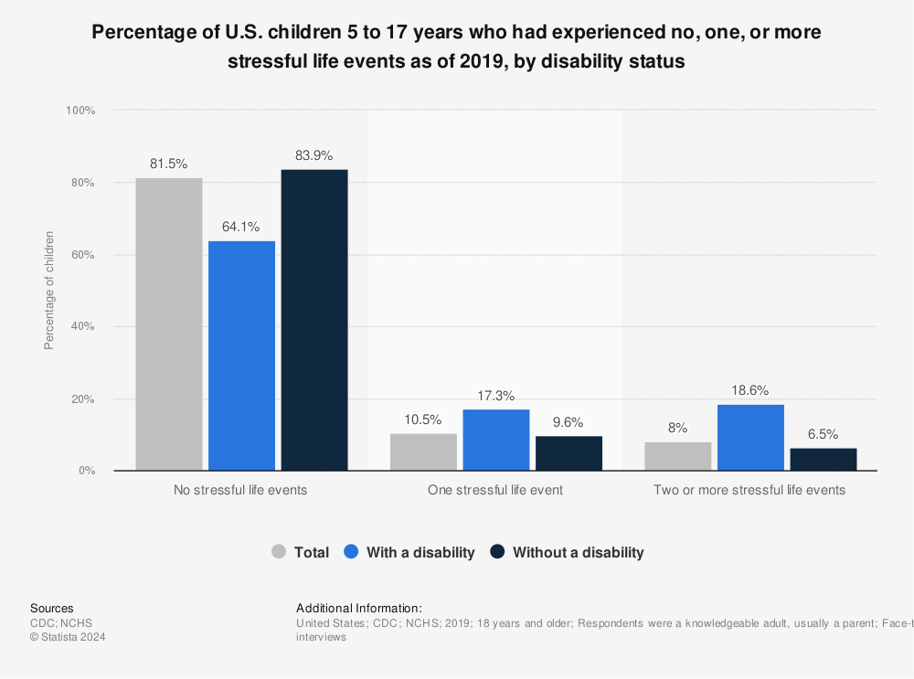
The rate of children with a disability experiencing two or more stressful events chart
Notes:
The rate of children with a disability experiencing two or more stressful events was 18.6 percent. In comparison, about 6.5 percent of children with no disability had experienced two or more stressful life events. This graph shows the percentage of U.S. children aged 5 to 17 who had experienced no, one, or more stressful life events as of 2019, by disability status.

Slide 11
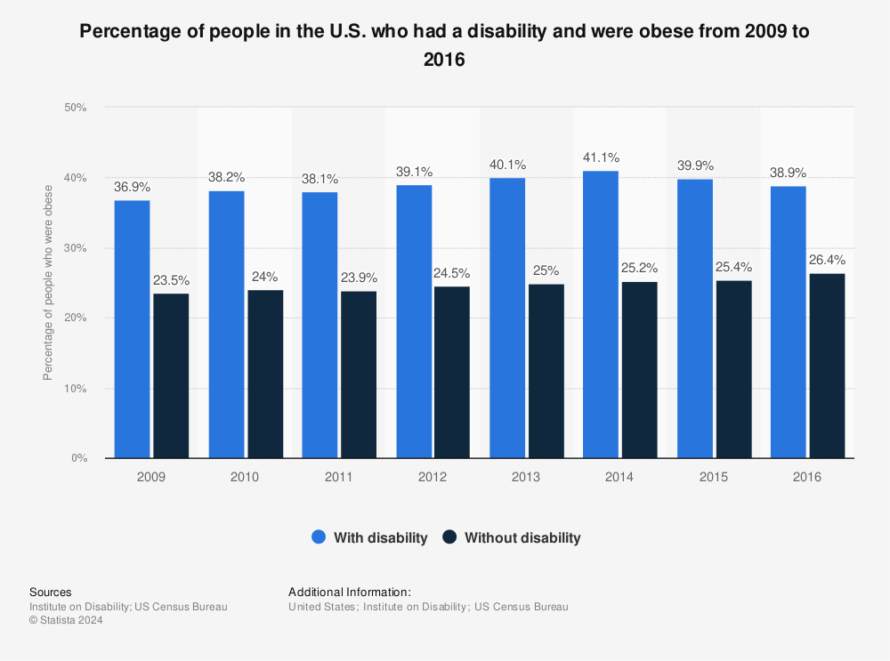
percentage of people in the U.S. who had a disability and were obese chart
Notes:
This statistic presents the percentage of people in the U.S. who had a disability and were obese from 2009 to 2016. In 2016, it was estimated that 38.9 percent of people with a disability were obese, compared to 26.4 percent of those without a disability.

Slide 12
Multi-jurisdictional Example:
Proposed Essex-Hudson Greenway Project in Northern New Jersey

Slide 13
The Proposed Essex-Hudson Greenway Project
Notes:
The proposed Essex-Hudson Greenway Project would offer a nearly nine-mile long, multi-use trail corridor following a converted rail line, creating more than 135acres of new green space when completed. The Greenway sets the stage for the creation of a nearly nine-mile transformational linear park that will provide new recreation opportunities for walkers, bikers, birders, and other nature lovers while improving transportation options for area residents.
Additional Challenges: Identifying and Understanding the Role of Disability and Equity Partners & Identifying and Involving Persons with Disabilities in Community Engagement Efforts

Slide 14
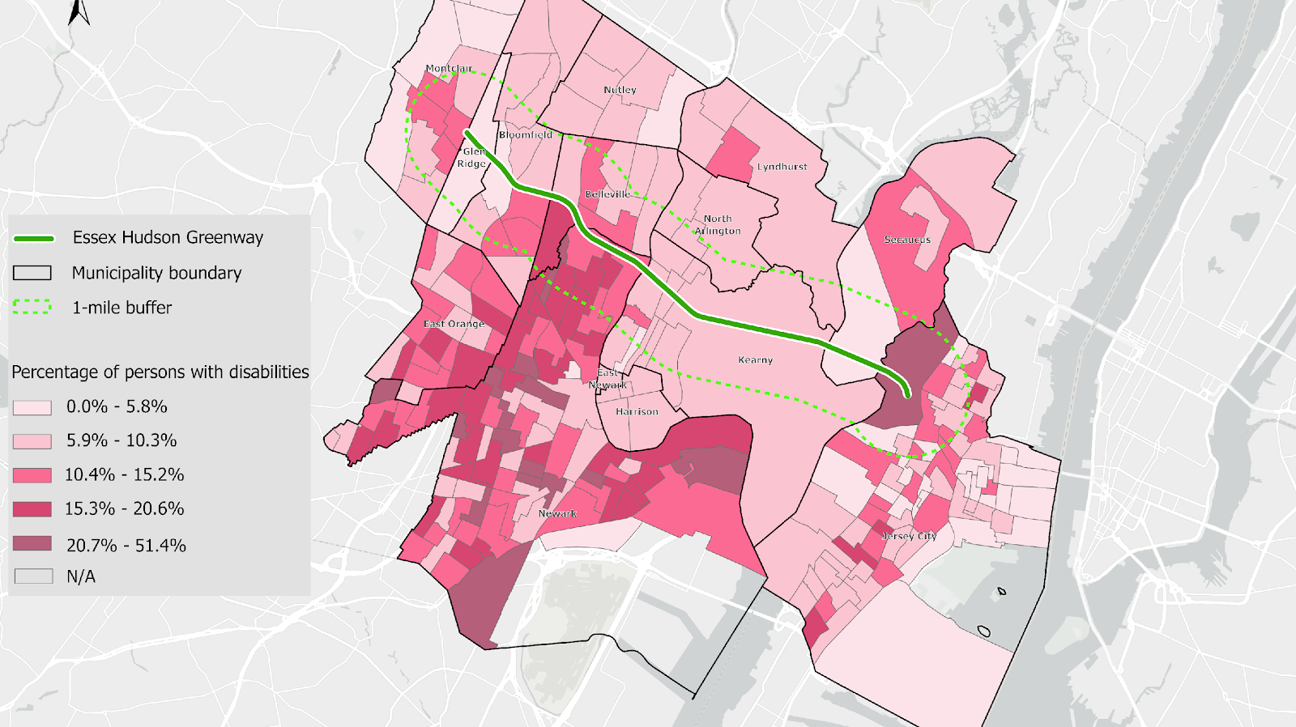
The Proposed Essex-Hudson Greenway Project (part 2)
Notes:
This variable shows the percentage of persons with various types of disabilities among the total civilian noninstitutionalized population.
Disability types are categorized as: hearing difficulty, vision difficulty, cognitive difficulty, ambulatory difficulty, self-care difficulty, and independent living difficulty. Note that children under 5 years old are not included in cognitive, ambulatory, and self-care difficulty measures.

Slide 15
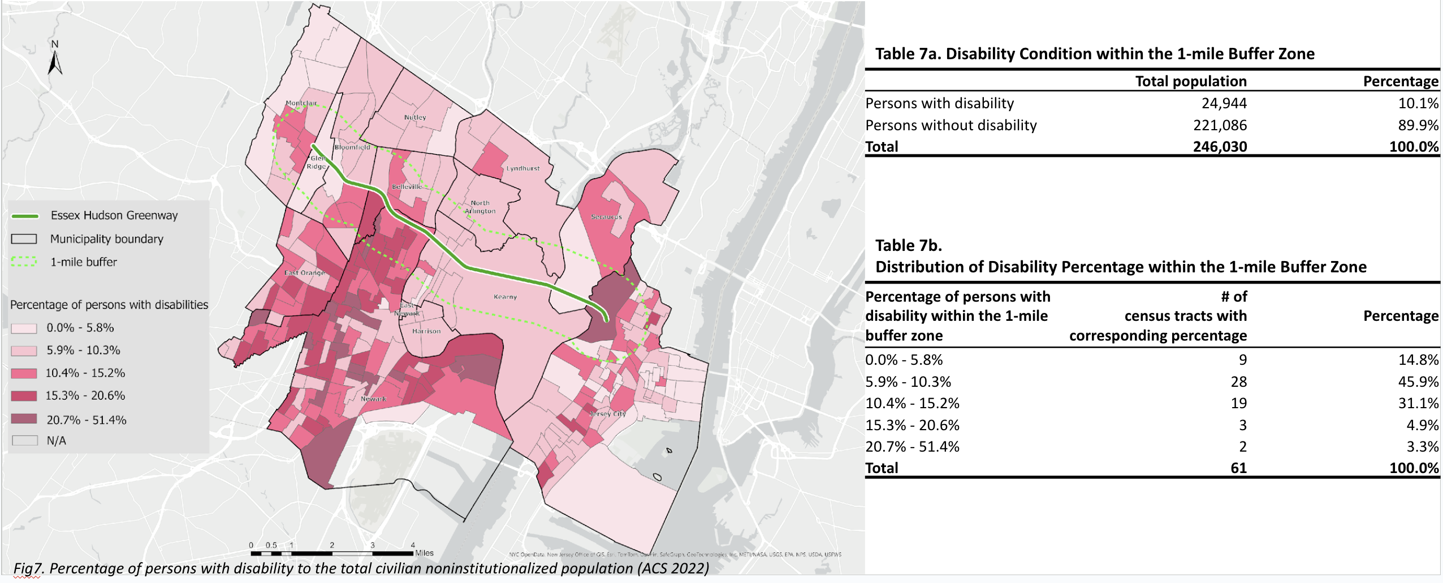
The Proposed Essex-Hudson Greenway Project (part 3)
Notes:
This variable shows the percentage of persons with various types of disabilities among the total civilian noninstitutionalized population.
Disability types are categorized as: hearing difficulty, vision difficulty, cognitive difficulty, ambulatory difficulty, self-care difficulty, and independent living difficulty. Note that children under 5 years old are not included in cognitive, ambulatory, and self-care difficulty measures.

Slide 16
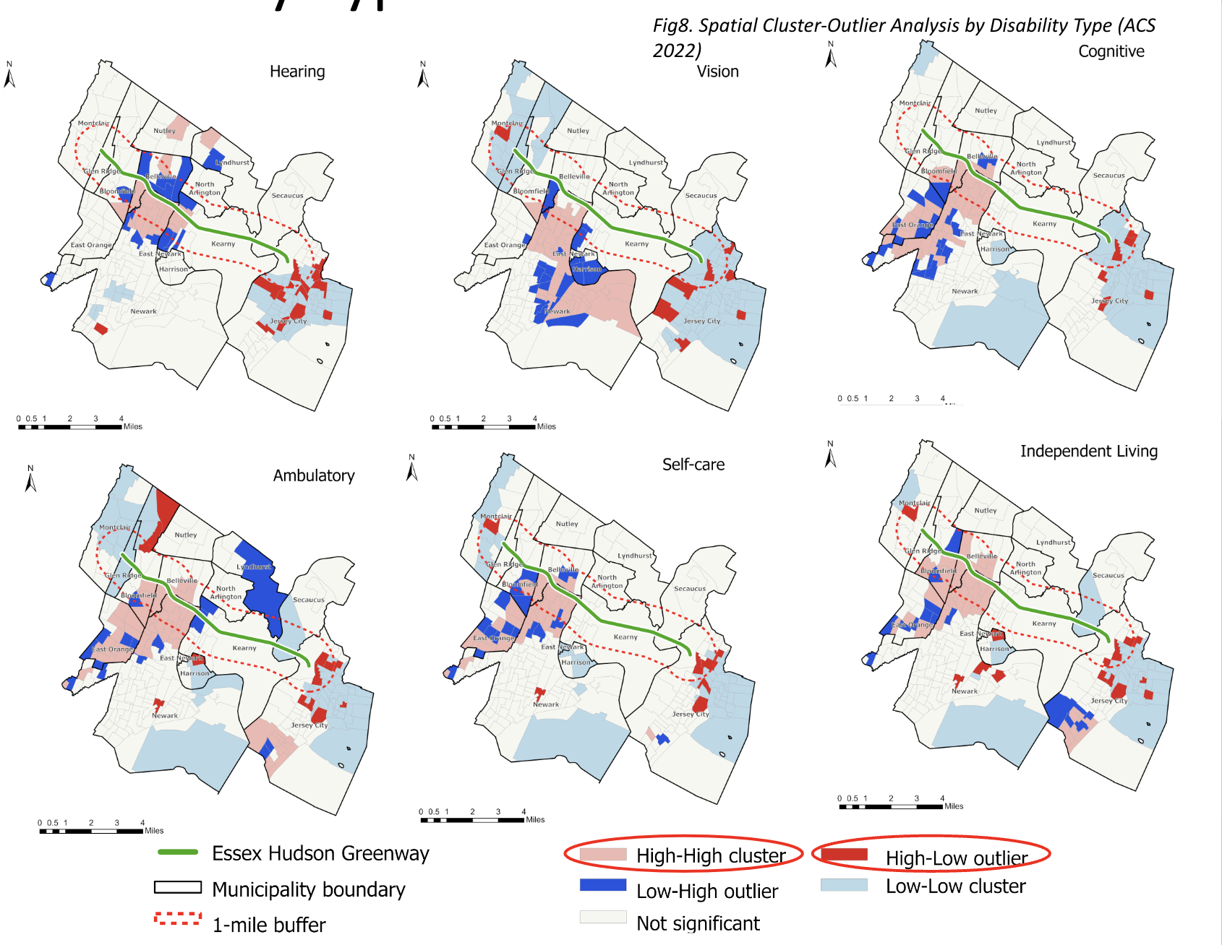
Spatial cluster-outlier analysis of disability type
Notes:
This variable shows the percentage of persons with various types of disabilities among the total civilian noninstitutionalized population.
Disability types are categorized as: hearing difficulty, vision difficulty, cognitive difficulty, ambulatory difficulty, self-care difficulty, and independent living difficulty. Note that children under 5 years old are not included in cognitive, ambulatory, and self-care difficulty measures.
The spatial cluster-outlier analysis, aims at accessing the geographic pattern of census tract-level disabilities.
High-High cluster: a significant cluster of a high-value census tract surrounded by high-value census tracts.
Low-Low cluster: a significant cluster of a low-value census tract surrounded by low-value census tracts.
High-Low outlier: a high-value census tract surrounded by low-value census tracts.
Low-High outlier: a low-value census tract surrounded by high-value census tracts.
High-High clusters and High-Low outliers are worth notice as they shed light on either cluster of areas or single areas with a higher population of certain disability. Furthermore, it helps identify high-prevalent areas with each type of disability.
This could ultimately enhance community engagement amount persons with disabilities.

Slide 17
Municipal Example:
The City of Savannah, Georgia
Notes:
Healthy Savannah
CPTED Analysis - CPTED, or Crime Prevention Through Environmental Design, is a set of design principles used to deter criminal behavior through the physical environment. This approach emphasizes the proper design and effective use of the built environment to lead to a reduction in the incidence and fear of crime and an improvement in the quality of life.
Complete Streets – Streets that designed, Operated and Maintained with Everyone in Mind.
CPTED (Crime Prevention Through Environmental Design) is particularly important for persons with disabilities for several reasons:
Enhanced Safety: Ensures safer navigation and access in environments, reducing vulnerability to criminal activities.
Increased Independence: Well-designed environments enable greater mobility and independence for persons with disabilities.
Reduced Isolation: Facilitates social interaction and integration by designing inclusive and accessible public spaces.
Empowerment: Promotes a sense of security and empowerment by enabling persons with disabilities to participate more actively in community life.
Needs:
Detailed mobility data across different types of disabilities
User satisfaction and safety perception data
Data on access to key destinations (e.g., parks)

Slide 18
Bowles C. Ford Park
Notes:
A local park for people to swim, fish, exercise, and enjoy social activities. However, it is divided by a local road that isn’t safe for children, young adults and seniors, and persons with disabilities to cross. We

Slide 19
Before after renderings

Slide 20
20
Notes:
Of note: Please also note specifically our intentionally inclusion of walking, running, and rolling paths as well.

Slide 21
Renderings showing usability enhancements

Slide 22
Kennedy Park

Slide 23
Before after renderings of Kennedy Park
Notes:
Historically Black community with many of those owning homes being seniors, with and without disabilities. There are many noted concerns including vehicular speeding, crime, lack of access, and unfortunately inactivity by children and young adults,

Slide 24
renderings showing usability enhancements for Kennedy Park
Notes:
Traffic garden: A traffic garden is a set of small-sized streets with scaled-down traffic features where children and other new learners practice, learn and have fun in a place that is free from motor vehicles. Traffic Gardens are known by many terms including Safety Towns, Safety Villages, Road Tracks, and Traffic Playgrounds. These spaces are designed to provide a practical, hands-on way to learn about biking skills, road safety, and how traffic works. They serve as a controlled environment where kids can gain confidence and master these critical life-long skills.

Slide 25
Rural Example:
Noxubee County, Mississippi
Notes:
How might redesigning our towns with a justice lens tackle systemic inequalities and ensure fair resource access for every community member?
Approaching the redesign of towns through a justice lens adds a deeper dimension to health equity strategies, focusing on addressing systemic inequalities and ensuring fair access to resources and opportunities for all community members. Here are additional strategies that incorporate a justice perspective:

Slide 26
“To understand the world, you must first understand a place like Mississippi!”
Notes:
How might redesigning our towns with a justice lens tackle systemic inequalities and ensure fair resource access for every community member?
Approaching the redesign of towns through a justice lens adds a deeper dimension to health equity strategies, focusing on addressing systemic inequalities and ensuring fair access to resources and opportunities for all community members. Here are additional strategies that incorporate a justice perspective:

Slide 27
Noxubee County Active Transportation Plan
Creating a Healthier Vermont
Project Overview
Collaboration between the Small Town Center at MSU and Equitable Cities
Funded by the Centers for Disease Control and AIM for CHangeE
Purpose: “Catalyst project,” meant to improve safety, comfort, and accessibility of active transportation throughout the county
Notes:
Project Overview
Collaboration between the Small Town Center at MSU and Equitable Cities
Funded by the Centers for Disease Control and AIM for CHangeE
Purpose: “Catalyst project,” meant to improve safety, comfort, and accessibility of active transportation throughout the county

Slide 28
Noxubee County Active Transportation Plan (part 2)
Creating a Healthier Vermont
Challenges
Rural Context with limited resources
“Inflexible” Street design and conditions
Unsafe traffic and personal safety conditions
Car culture
Rapidly expanding and popular ATV culture
Notes:
Challenges
Rural Context with limited resources
“Inflexible” Street design and conditions
Unsafe traffic and personal safety conditions
Car culture
Rapidly expanding and popular ATV culture

Slide 29
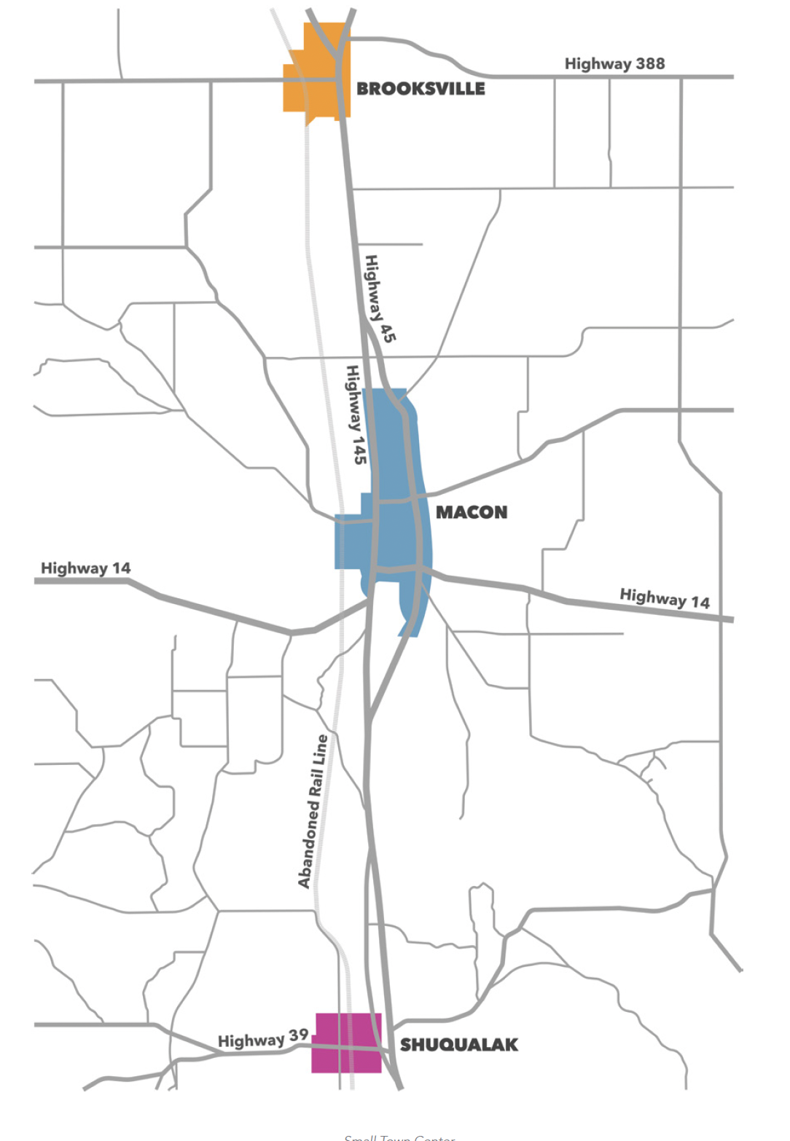
Noxubee County Active Transportation Plan (part 3)
Creating a Healthier Vermont
Select Findings
Need for investments in public parks
Need for investments in sidewalks and existing walking tracks
Need for increased access to popular destinations such as businesses
Revitalization of each downtown
Access to alternative modes of transport
Notes:
Many of the streets in and around Brooksville,
Macon, and Shuqualak provide limited options for
implementing active transportation infrastructure.
On the one hand, most of the residential streets
(without sidewalks) in the towns are narrow and
have no shoulder to work with. On the other hand,
several of the major streets through each town are
also classified as state highways, making installing
new infrastructure along these routes complicated.

Slide 30
Noxubee County Active Transportation Plan (part 4)
Creating a Healthier Vermont
Project Outcome
Establishment of Bike Noxubee!
Notes:
Needs:
Detailed mobility data across different types of disabilities
User satisfaction and safety perception data
Data on access to key destinations (e.g., parks)

Slide 31
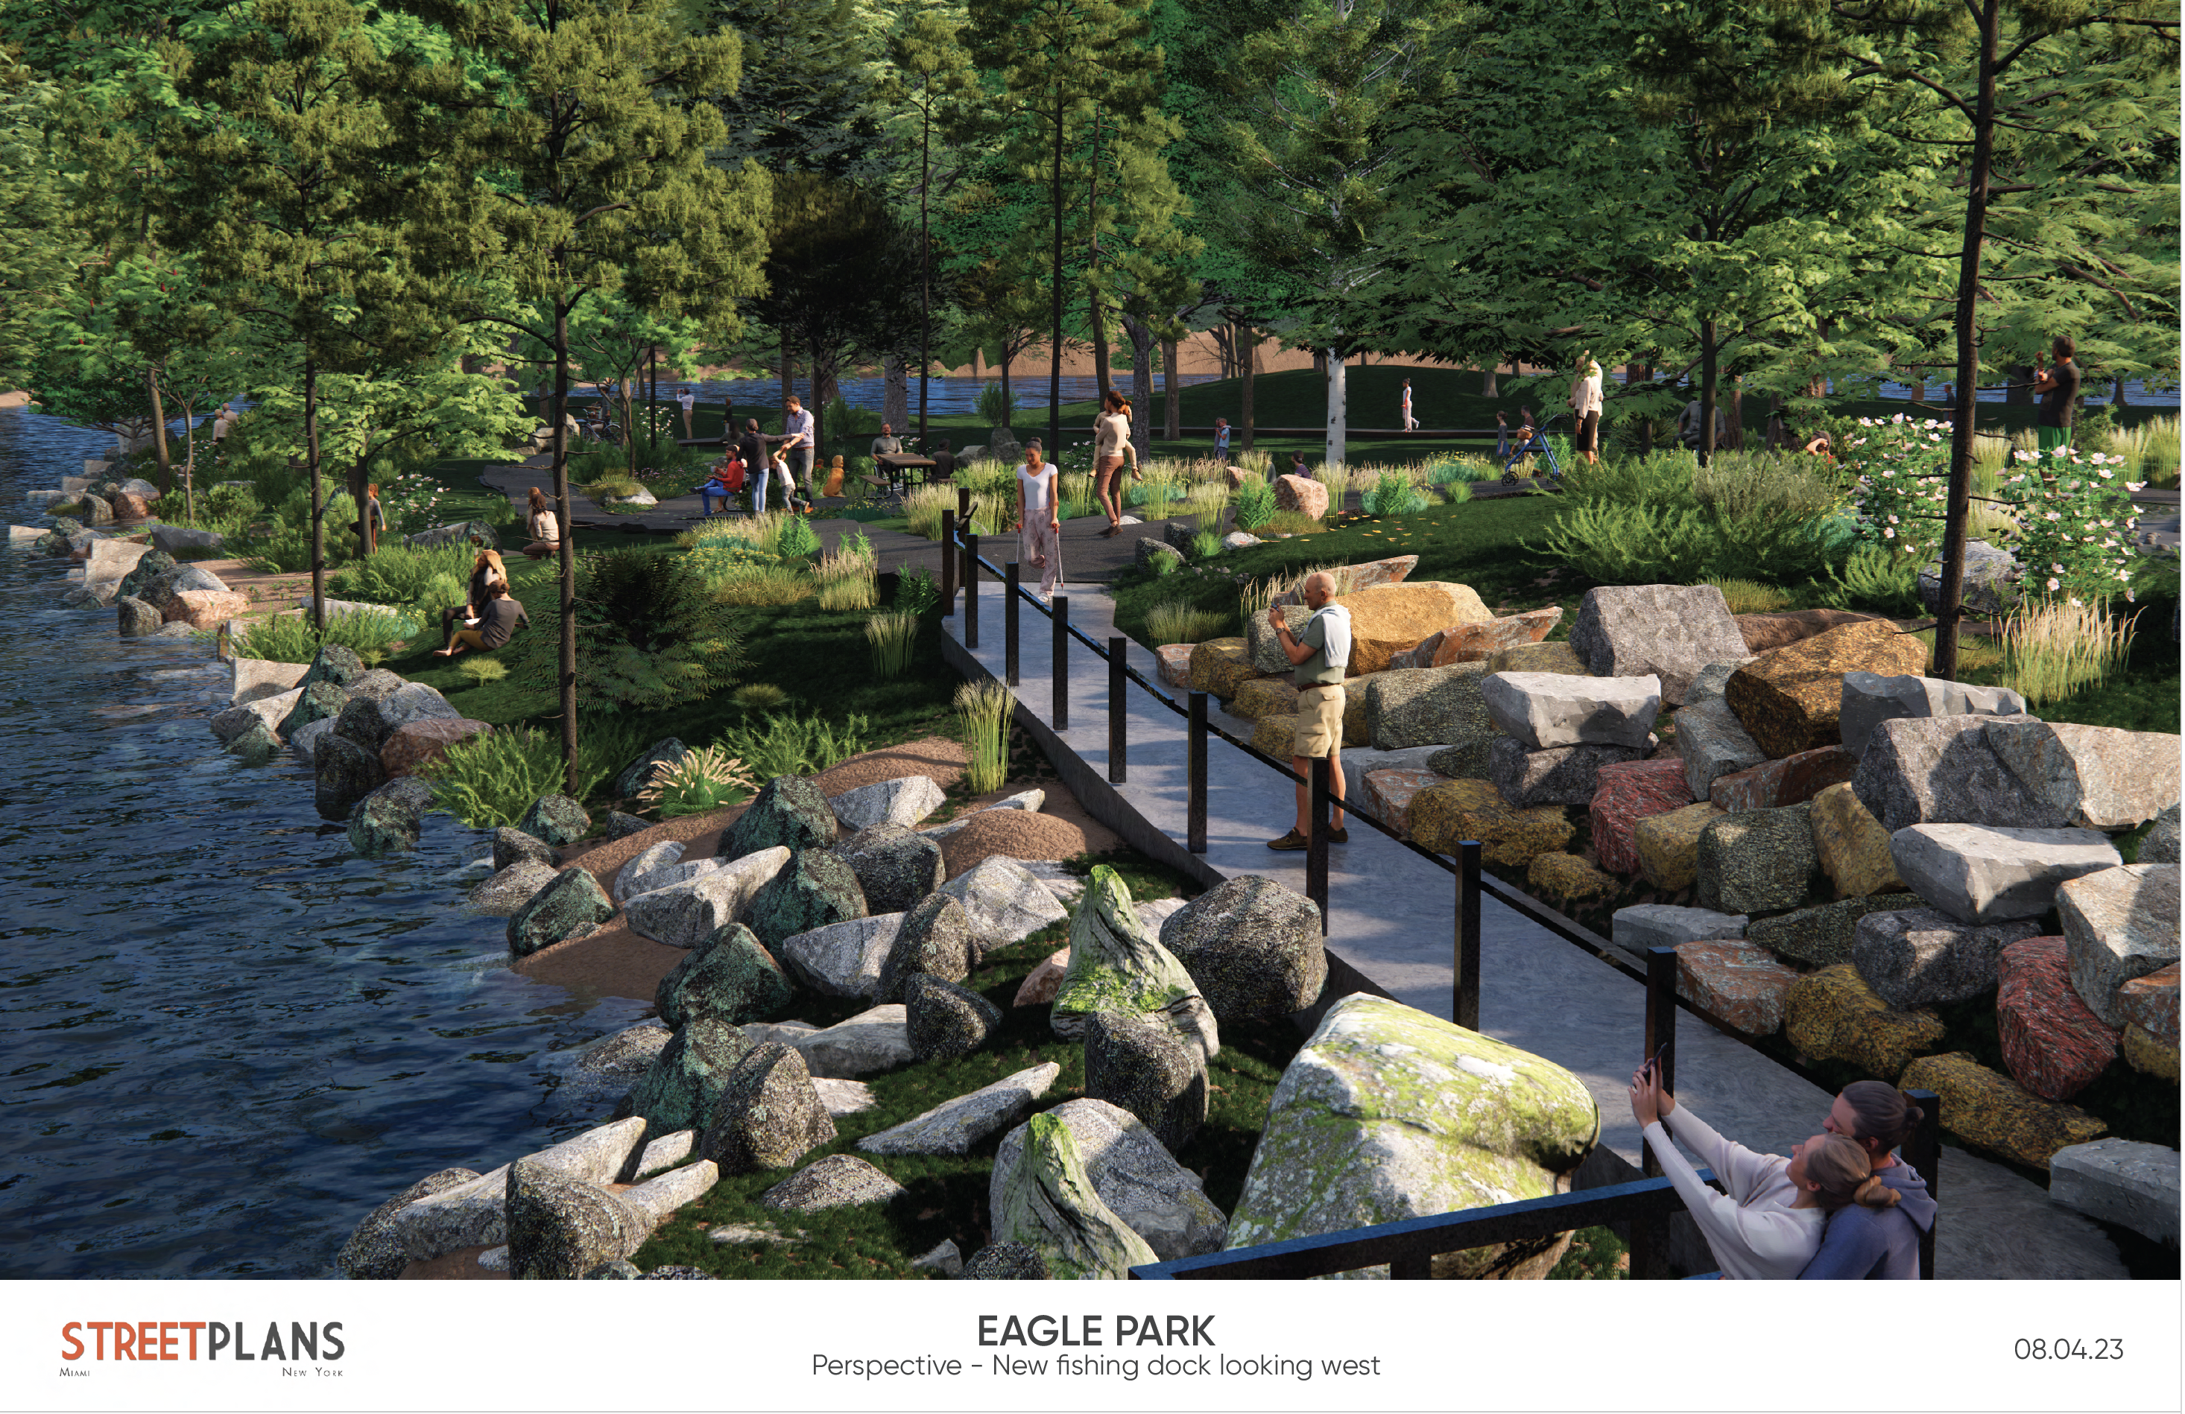
Thank You!
Charles T. Brown, MPA, CPD, LCI
Email: charlesbrown@equitablecities.com
www.equitablecities.com

