Slide 1
Weather.gov 2.0 x Partnership for Inclusive Disaster Strategies
Tue May 7th

Slide 2
We envision a future where anyone can understand the impact of impending weather. When it comes to making decisions to save life and property, every word and every minute matters.
Our vision

Slide 3
Rebuild weather.gov to reflect the integrity and care you have for the people you serve.
Our mission
Notes:
Additional VO: Weather.gov 2.0 will succeed if everyone sees the site reflect their values, much like the agency. Because the mission and culture at NWS is built around serving, preparing, and protecting people, the site must do the same.

Slide 4
beta.weather.gov demo
Notes:
https://beta.weather.gov/

Slide 5
Building iteratively with feedback
Learn about challenges users face
Design features or improvements
Get feedback on those features
Improve the website

Slide 6
Conducting research with the “public”

Slide 7
Defining the “general public”
All are at risk of experiencing weather hazards, whether it’s a snowstorm, tornado, hurricane or wildfire.
While we don’t all have the same resources or abilities, some of the challenges with the existing experience impact many groups. For example, when weather information uses technical language, it makes it harder for many folks without the expertise to interpret.
But for folks with disabilities, low literacy and less resources, these challenges are magnified.

Slide 8
What dimensions impact what the “public” needs?
A person’s understanding of weather information generally (ie weather expertise)
Past experience with the specific weather hazard
Access to technology / internet during a weather hazard
Learning preferences (numbers, words, visuals)
Physical, cognitive and language barriers to interpreting weather information
Physical barriers to responding to weather information

Slide 9
Recruitment
Sign up to participate via a survey (PRA approved)
Schedule 5 minute “screener” to ensure the person is a good fit
When a research opportunity is a good fit, reach out to schedule a research session
Notes:
There’s two pieces of this - we’re recruiting folks to participate in ongoing research opportunities.
The first piece is a survey to recruit folks:
https://docs.google.com/forms/d/e/1FAIpQLSeD0-i-rytACvinNehGHRWKQv1JpjfwDNDthXjl6kQ2xV2cbg/viewform
The actual research sessions are typically an hour, and are compensated for their time. Essentially folks take some time to use the website and tell us any challenges or concerns.
That said - we’re also open to different options. The research sessions themselves could be “unmoderated” if you think that would be helpful - basically give folks a link to a self-guided tool.
We also would be open to having ya’ll supply a list of folks that you have vetted, and basically not own the data.
Sign up for screener → screening conversation → schedule appt → appt

Slide 10
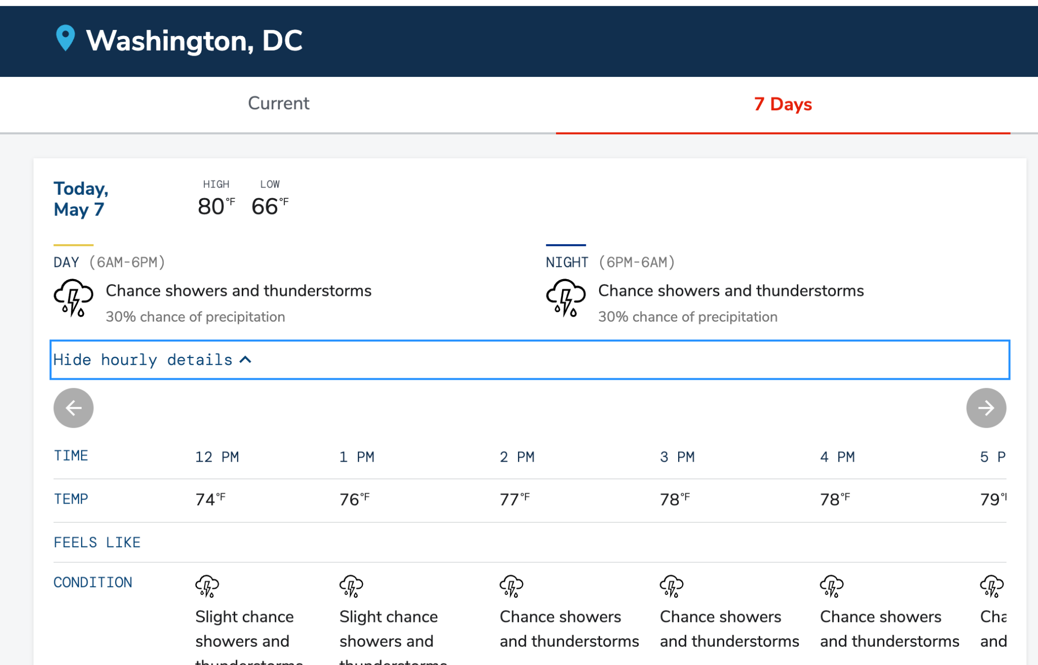
Moderated research sessions
“Tell me about the weather today”
“What’s missing?”
“What’s confusing?”

Slide 11
Weather.gov 2.0 x Partnership for Inclusive Disaster Strategies

Slide 12
We’ve recruited over 200 members of the public, but it’s not a group representative of the people we want to serve
We’ve been able to recruit some blind and deaf participants to date, but would be open to more
Particularly interested in folks with other challenges - people who are marginalized, stigmatized or excluded, older adults, individuals with limited language proficiency, low literacy, temporary and chronic health conditions, pregnant women and people experiencing homelessness, limited access to transportation or the financial resources to prepare for, respond to, and recover from a disaster.
The site is currently in english, we’ll be starting in on other language support in the next 6 months

Slide 13
We could use help reaching the folks that we’ve had less ability to connect with
Sharing the survey with folks in your communities to sign up to participate or recruit folks directly and work with them to schedule if concerns on data sharing
We’d also be interested in subject matter experts supporting on things like safety information
The opportunity is available through september, although hoping can make it ongoing.

Slide 14
What is the timeline for the overall process?
We’re working to incorporate feedback into our development frequently, balancing with other goals and needs of the project.
For some feedback, we’re able to quickly update, for more complex or high level feedback it might take longer.
If we did a round of research with folks you identified, we could provide a summary of what we learned and how we will use the feedback.

